Slide 1
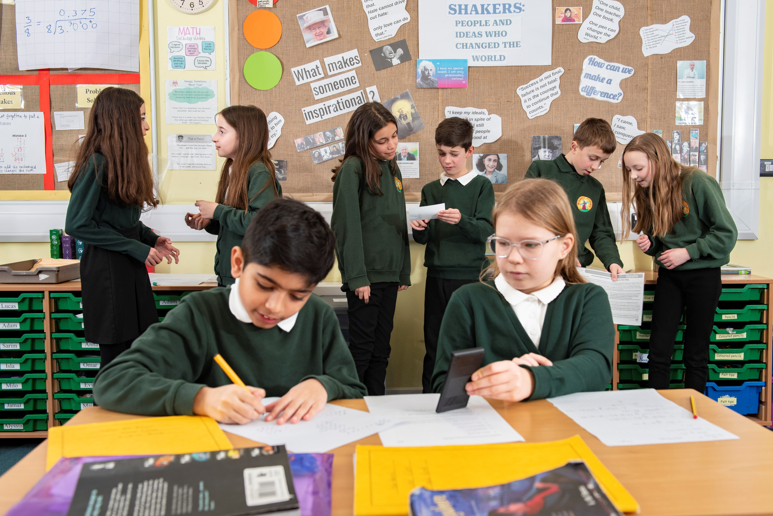

Design an advice centre

Slide 2
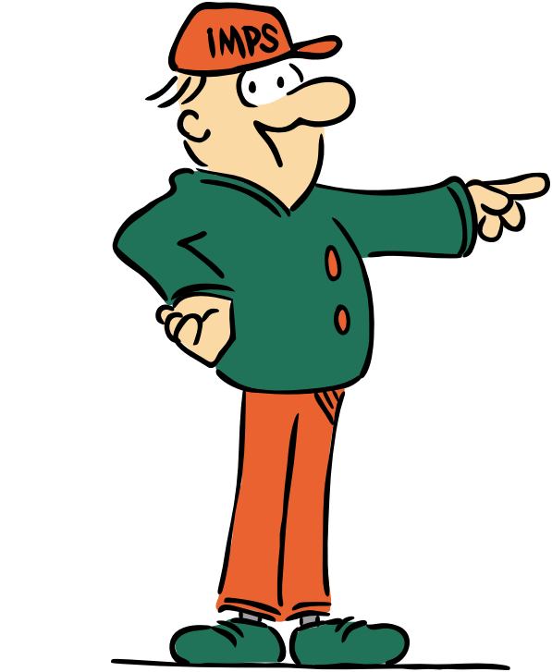
Welcome to the I.M.P.S. team!
Now you are in year 6 you automatically become a member of the I.M.P.S. team!
I.M.P.S. is a special programme that teaches you how to be responsible for the risks you take and how to make them safer. It also teaches you what to do in an emergency.
Every month we are going to give you an I.M.P.S. mission to complete. We would love it if you let us know what you do at your school and send us some images.
Find out more about I.M.P.S. at www.impsweb.co.uk Your teacher will do some lessons with you and book a visit from our I.M.P.S. trainers to teach you lots of useful emergency skills.

Slide 3
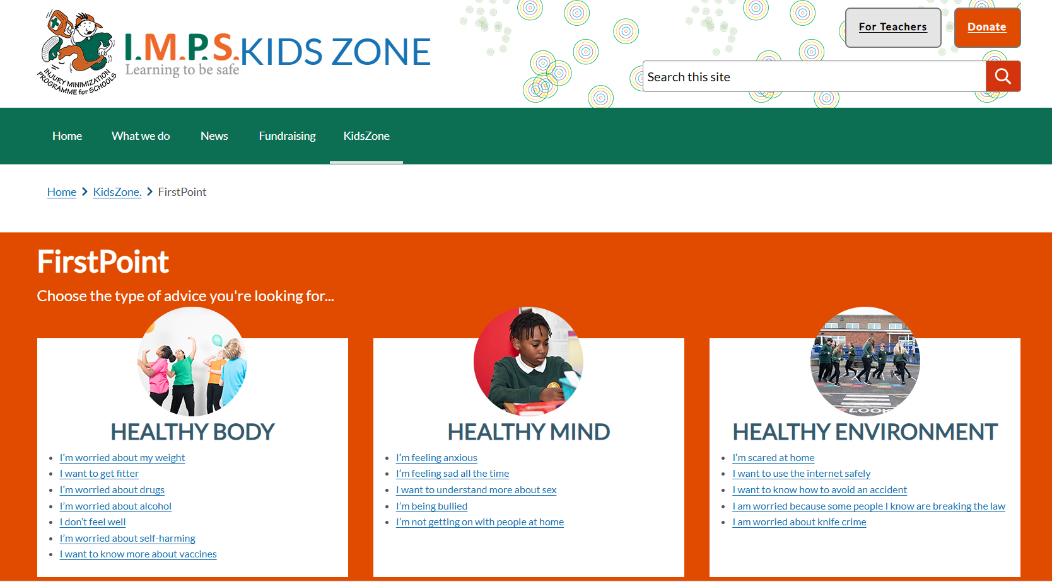

Do you know about FirstPoint?
www.impsweb.co.uk

Slide 4
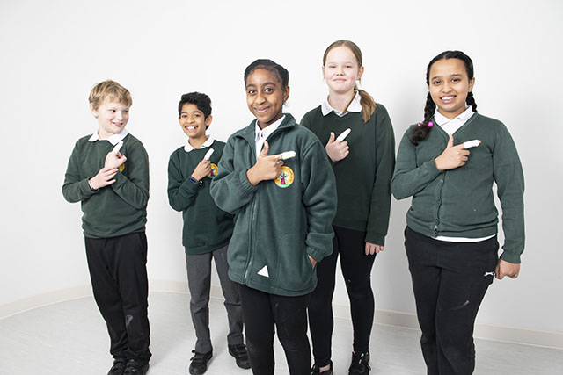
FirstPoint
FirstPoint is an online advice centre where you can go if you are ever worried or frightened about something that is happening to you, your friend or your body.
The I.M.P.S. FirstPoint link will signpost you to websites that will give you help, advice and support connected with feeling safe and well.
This is the link from the I.M.P.S. website home page.

Slide 5

Your mission
You are going to make an advice centre for children who move up to year 6 next September.
As a class, go to www.impsweb.co.uk and follow the links to FirstPoint. Have a look at what issues are discussed.
Decide what the most common worries for new Year 6s might be and make a list of them.

Slide 6
Activity
As a class, discuss how you want your advice centre to look and how it may be accessed by pupils.
e.g. Are you going to collect the advice into a folder?
Are you going to use a notice board?
Will it be displayed in your school library or in the classroom?

Slide 7
Activity
In groups of two or three, choose a subject from those you put on your list.
As there is a lot of information about each subject it is important to choose just one topic to work with.*
e.g. if you decide to pick “Bullying” then choose cyberbullying or bullying at school.
e.g. If you choose “Getting fitter” chose 3 reasons children should play sports or why it is important to have enough sleep.
* Your teacher may give you a list the topics to research to make sure that you do not all chose the same one!

Slide 8
Things to do.
When you have chosen your topic, make a poster or a leaflet with information and advice for new year 6s. Make sure you keep it simple with a maximum of 3 pieces of advice and links.
Display this information in your advice centre.
Spend some time looking at all the information each group has contributed.
Talk about your advice centre to the year 5s so they know how to find the information.

Slide 9
Conclusion
Write a newspaper report about your advice centre and take some photographs. Add some quotes from year 5s and teachers.
Send the report and images to I.M.P.S. to put on their website.
Write and let I.M.P.S. know if you think of another subject that should be added to FirstPoint. Email: imps@ouh.nhs.uk

Slide 10
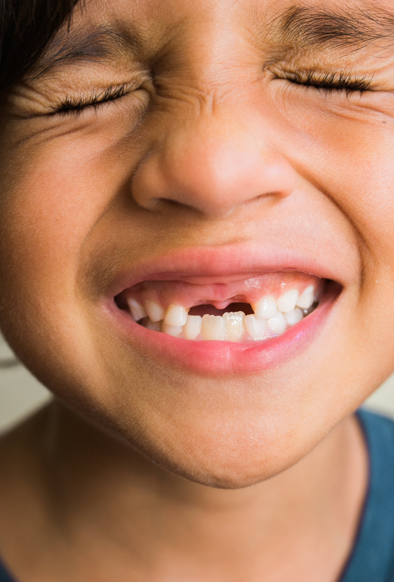
Ask for help!
Don’t forget to ask for help if you are worried or frightened about anything or if you think one of your friends is having problems.
Places to go for help:
Talk to your teacher or a trusted adult.
Go to FirstPoint for advice and support.
Talk to the school nurse.
Telephone or chat to a helpline (details found on FirstPoint)
The most important thing to remember is that you are not the only person to be worried by this issue. It has happened to someone else before.
Talk to someone and share your worries.

Slide 11

Thank you
Don’t forget to let I.M.P.S. know all about your missions! email: imps@ouh.nhs.uk

Slide 12


