Slide 1
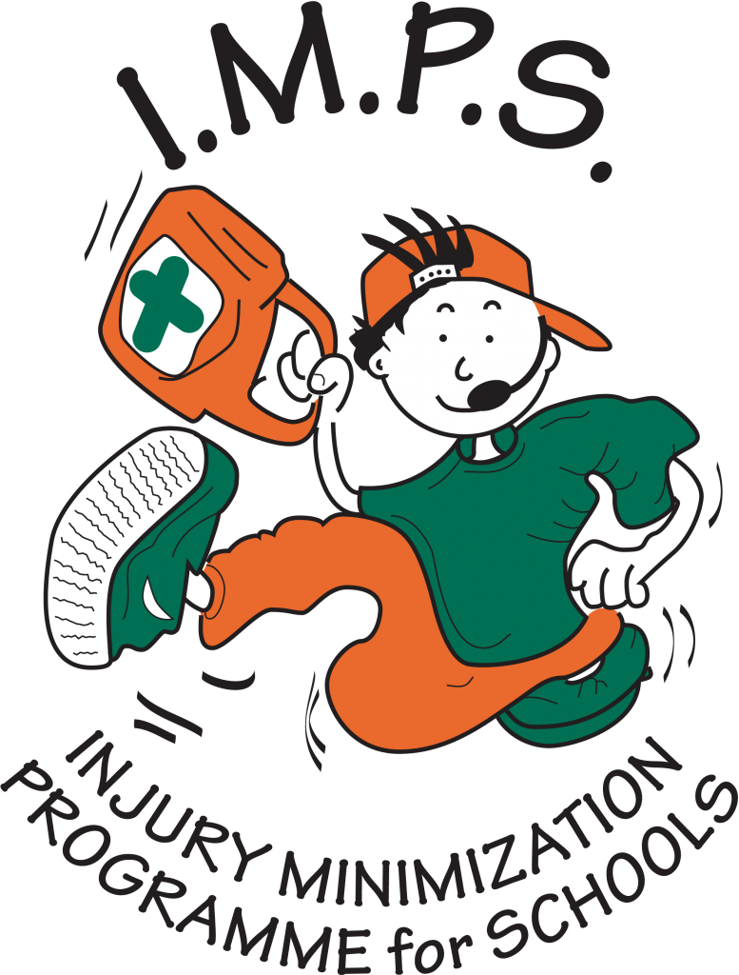
Injury Minimization Programme for Schools

Slide 2
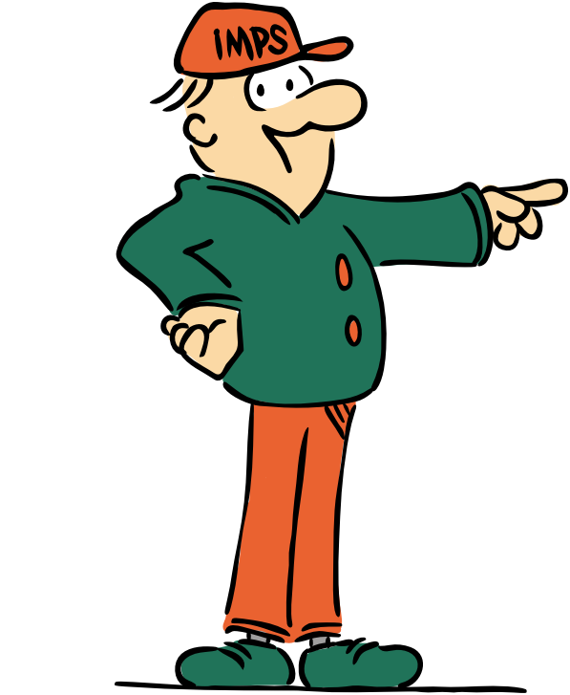
Welcome to the I.M.P.S. team!
Now you are in year 6 you automatically become a member of the I.M.P.S. team!
I.M.P.S. is a special programme that teaches you how to be responsible for the risks you take and how to make them safer. It also teaches you what to do in an emergency.
Every month we are going to give you an I.M.P.S. mission to complete. We would love it if you let us know what you do at your school and send us some images.
Find out more about I.M.P.S. at www.impsweb.co.uk Your teacher will do some lessons with you and book a visit from our I.M.P.S. trainers to teach you lots of useful emergency skills.

Slide 3
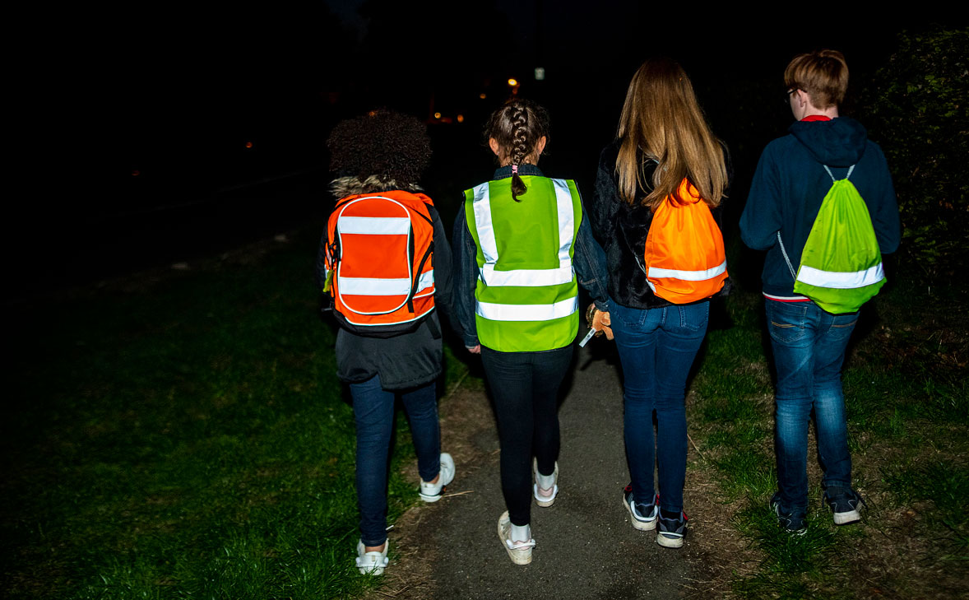

Be Bright
Be Seen
Be Safe

Slide 4


What happens in October of every year?

Slide 5
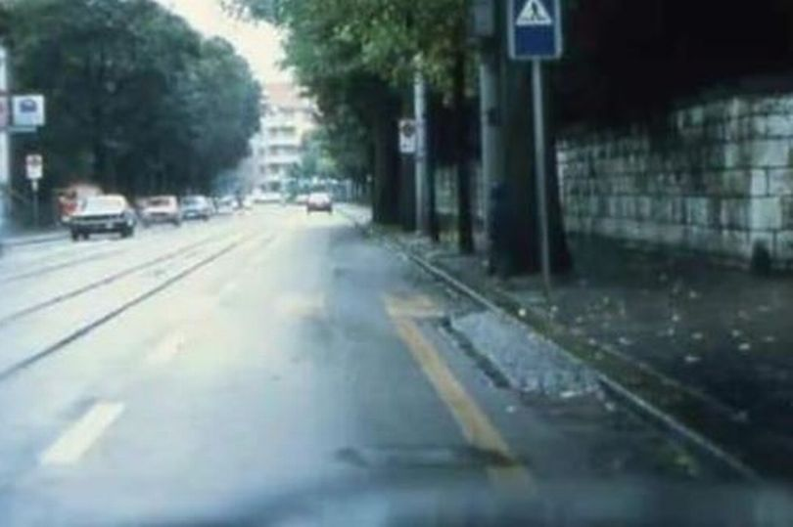

What does this mean for your journey to and from school?
Can you see the child waiting to cross the road?

Slide 6
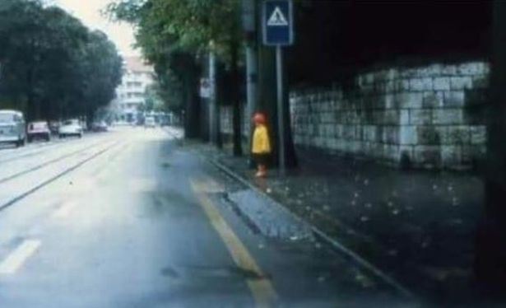
What can you do to make yourself a brighter pedestrian (or cyclist)
Here is the same image with the child wearing a bright coat.

Slide 7
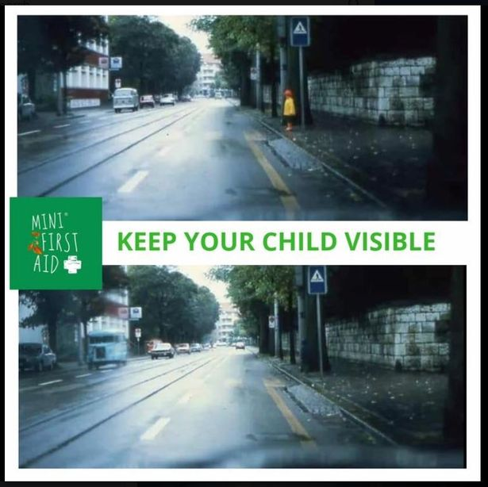

Many people wear dark clothing and this makes them really difficult to see in the twilight and dark. If a motorist can’t see you, they may run into you.
Did you spot the ‘hidden’ child?

Slide 8
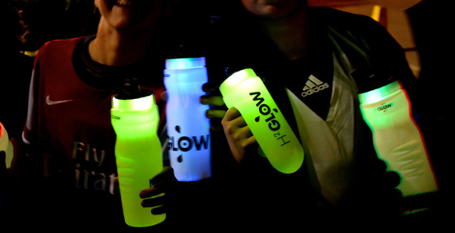
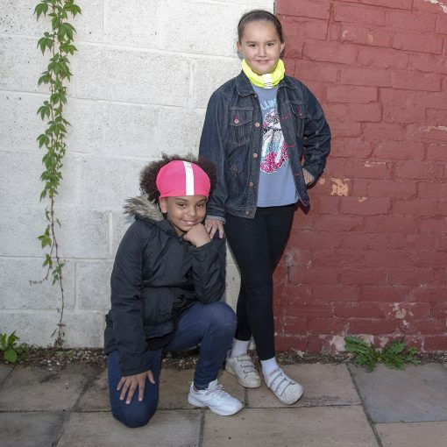
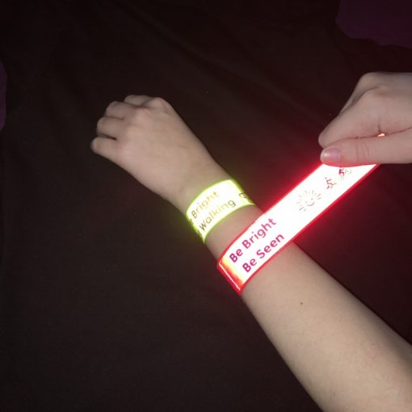
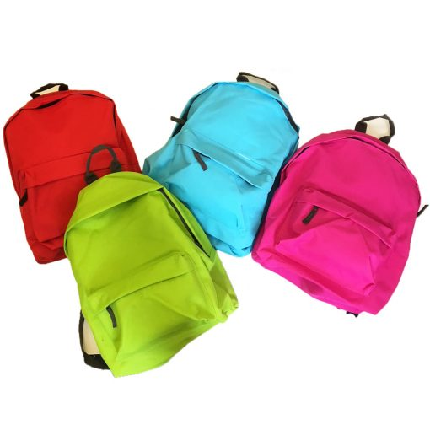
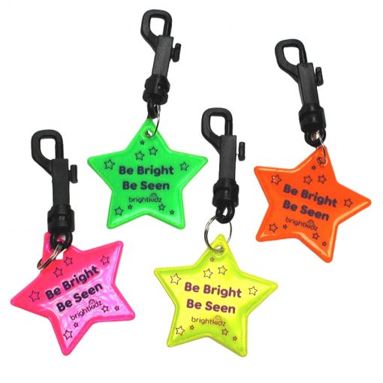
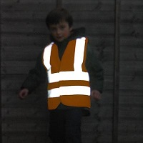
There are lots of ways that you can be bright and be seen.

Slide 9
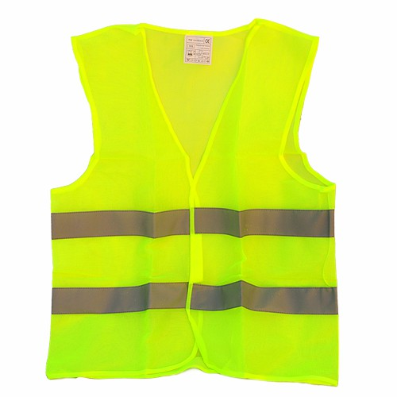
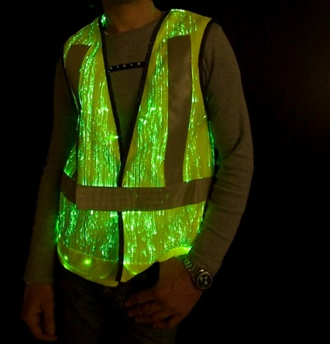
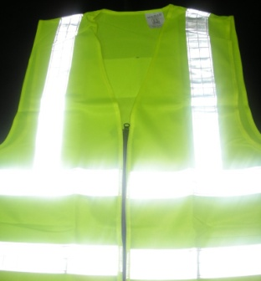

Science question
What is the difference between these materials?
Reflective
Luminous
Florescent
Can you spell these words?

Slide 10
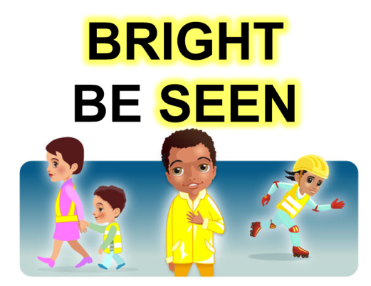
The younger children in your school look up to you now you are in year 6. They will copy your behaviour and the things you like and do.
Your mission
You can really help to pass on the I.M.P.S. safety messages.
Your mission is to encourage them to be bright, be seen and be safe this winter.
Discuss this in a group and list your ideas.

Slide 11

Mission ideas
As a class or in groups plan a project to pass on this safety message to the younger children in your school.
Here are a few ideas to get you started.
Plan an assembly for the rest of the school
Lead by example (wear bright outdoor clothing or reflective flashes to school).
Organise a “be bright, be seen” day at school and raise money for I.M.P.S.
Customise your school bag with reflective, luminous and florescent flashes.

Slide 12
Pass it on!
Please tell us all about your project.
Send us some photos and a report of what you have done in your school to make everyone brighter and safer this winter
We will put the best ones on our website
Thank you.

Slide 13
Thank you
Don’t forget to let I.M.P.S. know all about your missions!

