Slide 1

Child Safety Week
2nd – 8th June 2025
Child Safety Week is the Child Accident Prevention Trust’s (CAPT) annual community education campaign over the UK.
It helps families build confidence and skills in managing the real risks to children’s safety.
CAPT want all children to have the freedom to grow and learn, safe from serious harm.
Share this presentation with your whole school to get the safety messages to as many people as you can.
Notes:
Information for the person taking the assembly

Slide 2

Welcome to the I.M.P.S. team!
Now you are in year 6 you automatically become a member of the I.M.P.S. team!
I.M.P.S. is a special programme that teaches you how to be responsible for the risks you take and how to make them safer. It also teaches you what to do in an emergency.
This month we are giving you a bonus I.M.P.S. mission to complete. We would love it if you let us know what you do at your school and send us some images.
Find out more about I.M.P.S. at www.impsweb.co.uk Your teacher will do some lessons with you and book a visit with our I.M.P.S. trainers to teach you lots of useful emergency skills.
Notes:
Slide if presentation is delivered to Year 6 children.

Slide 3



Child Safety Week
This year CAPT’s theme is….
Safety is for sharing
Notes:
Start of assembly

Slide 4
Child Safety Week
Can you think of anything in your house which could be a danger to you and your family?
Make a list.
These are a few things which we came up with:
Burns from:
Hot drinks
Cooking
Hair straighteners and wands
Kettles and flasks
Baths and showers
Hot water bottles
Radiators
BBQs
Toys:
Cheap copies of toys
Button batteries
Water beads
Broken toys
Loose wires
Long cords
Choking from:
Small toys
Sweets
Large pieces of food
Poisons:
Laundry capsules
Painkillers
Cleaning products

Slide 5
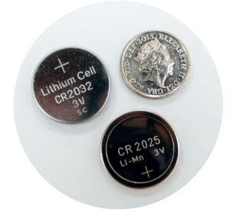
Child Safety Week
These are button batteries; they are the same size as 5p and 10p coins.
Can you think of anything at home or school that uses button batteries?
Safety is for sharing

Slide 6
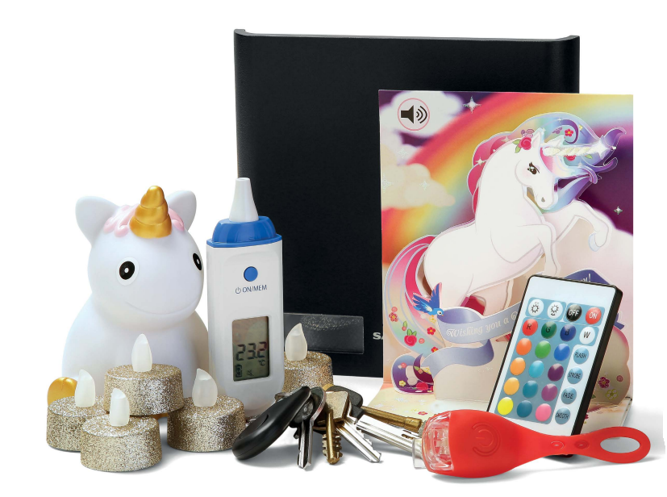
Child Safety Week
All of these items use button batteries.
Notes:
You could have a range of items which use button batteries on show.

Slide 7
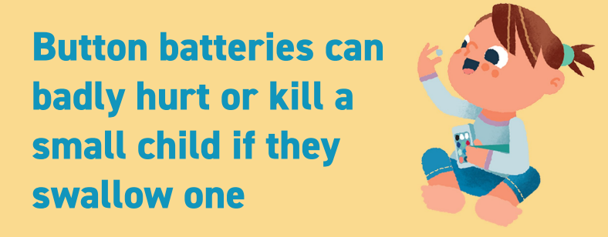
Child Safety Week
How could you make this safer at home?

Slide 8
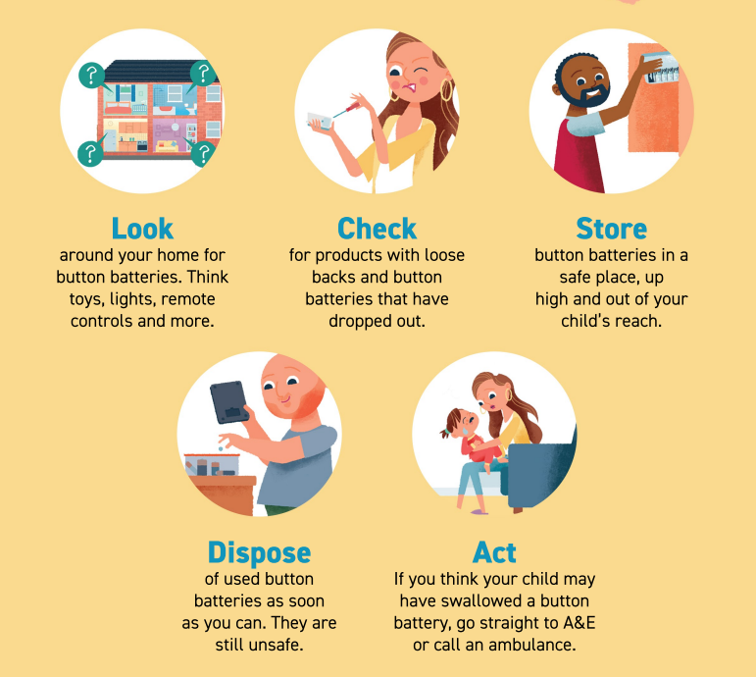
How can you help?
Share this information with your adults at home.
Safety is for sharing

Slide 9
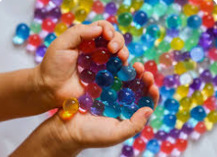
Child Safety Week
Do you play with water beads?
Do you know that they can be really dangerous if swallowed?
Notes:
Have some water beads to show the children.

Slide 10

How can you help?
Share this information with your adults at home.
Safety is for sharing

Slide 11
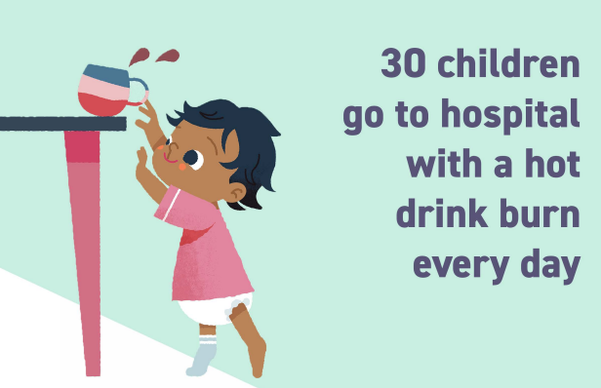
Child Safety Week
How could you make this safer at home?
Notes:
Ask the children for ideas.

Slide 12
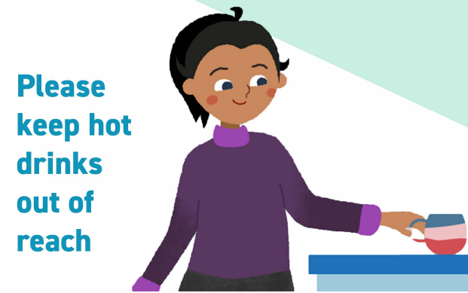
Child Safety Week
Notes:
Ask the children for ideas.

Slide 13
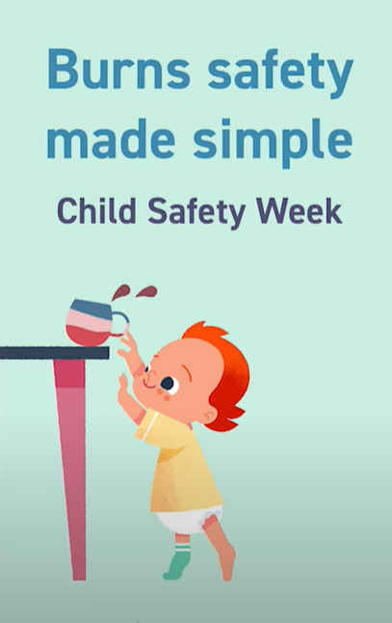
What do we do if someone is burnt?
Watch this film which shows you how to help someone who has a burn.
https://youtu.be/5aNhZ8HYjfk

Slide 14
How can you help?
Share the information with the adults in your house.
If someone is burnt:
Cool, call, cover
Remove any clothing from the area.
Put the affected area under cool running water for 20 minutes.
For any burn larger than a 50p coin call NHS 111 or contact your GP for advice. In an emergency call 999.
After cooling cover the burn with clingfilm or sterile non-fluffy dressing or cloth.
Safety is for sharing

Slide 15
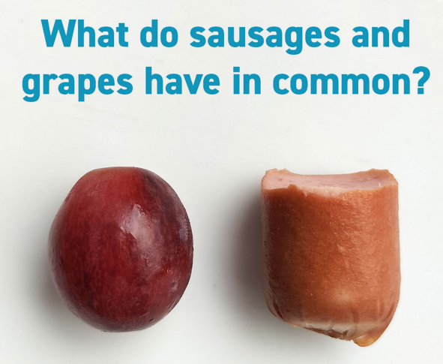
Child Safety Week

Slide 16
Child Safety Week
They can cause choking.

Slide 17
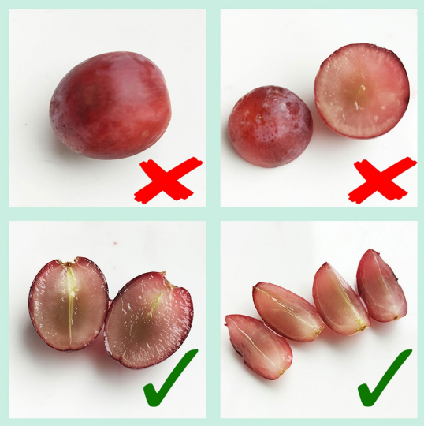
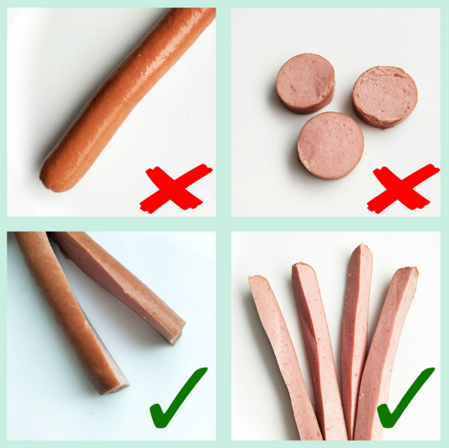
How can you help?
Share the information with the adults in your house.
To avoid choking, cut these foods lengthways.
Safety is for sharing

Slide 18
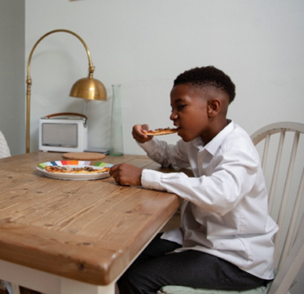
What do we do if someone chokes?
Watch this film which shows you what to do if someone chokes.
https://youtu.be/e9aoHLax1tw

Slide 19
How can you help?
Share the information with the adults in your house.
If someone is choking:
Give up to five back blows between the shoulder blades – it can force the object out.
For children over 1 year of age, give up to five abdominal thrusts squeezing above the belly button from behind – it forces air out of the lungs to clear the object.
If 1 & 2 don’t work call 999 and keep trying until help arrives.
Safety is for sharing

Slide 20

Your mission
When you go home today share the safety messages with your family to keep your family safe.
Button batteries
Water beads
Hot drinks
Choking
There is a lot of advice and resources about how to keep safe on CAPT’s website at https://capt.org.uk/child-safety-week/

Slide 21
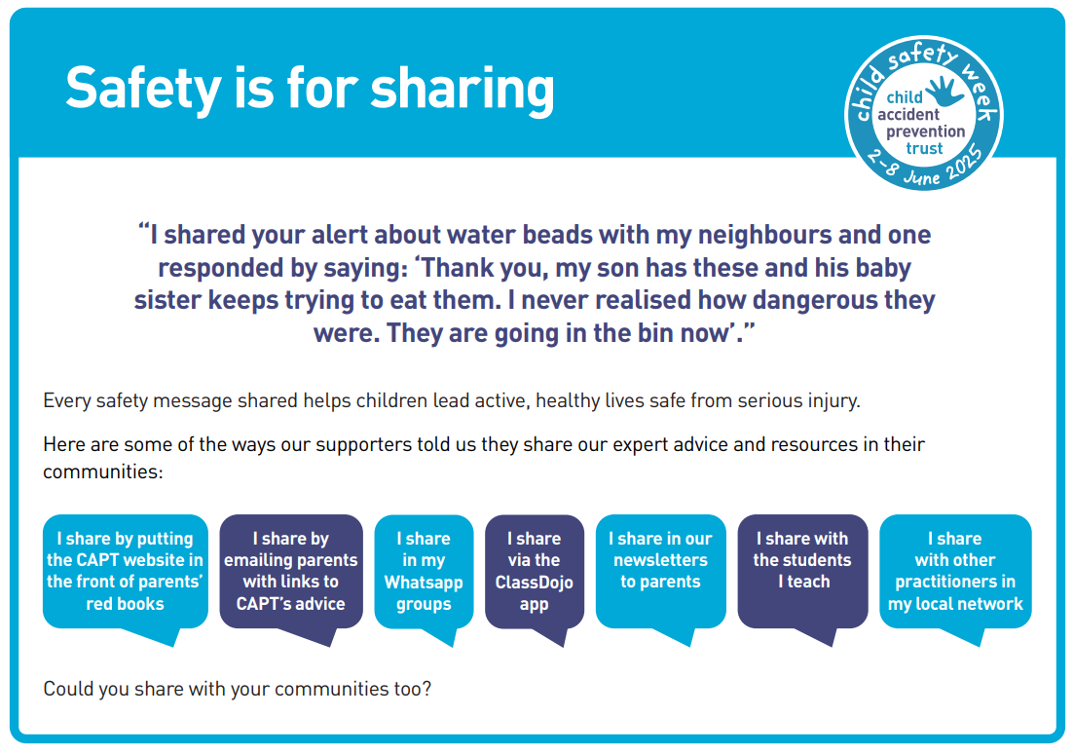
Other people have shared this information too.

Slide 22

Remember
Safety is for sharing

Slide 23

Thank you
Don’t forget to let I.M.P.S. know all about your missions!

Slide 24


