Slide 1

What is an organ donor?
You can find a full presentation and many more about organ donation at Resources Hub - THE ORGAMITES MIGHTY EDUCATION PROGRAMME

Slide 2

Welcome to the I.M.P.S. team!
Now you are in year 6 you automatically become a member of the I.M.P.S. team!
I.M.P.S. is a special programme that teaches you how to be responsible for the risks you take and how to make them safer. It also teaches you what to do in an emergency.
Every month we are going to give you an I.M.P.S. mission to complete. We would love it if you let us know what you do at your school and send us some images.
Find out more about I.M.P.S. at www.impsweb.co.uk Your teacher will do some lessons with you and book a visit from our I.M.P.S. trainers to teach you lots of useful emergency skills.

Slide 3

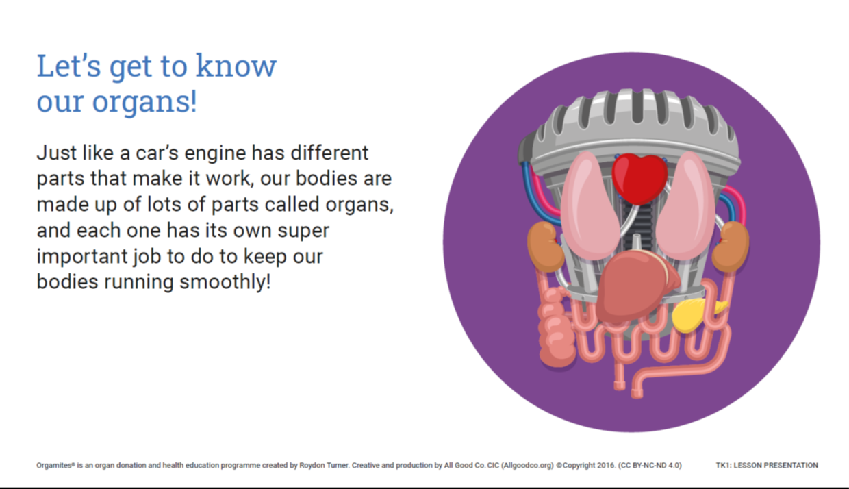
What are organs?

Slide 4
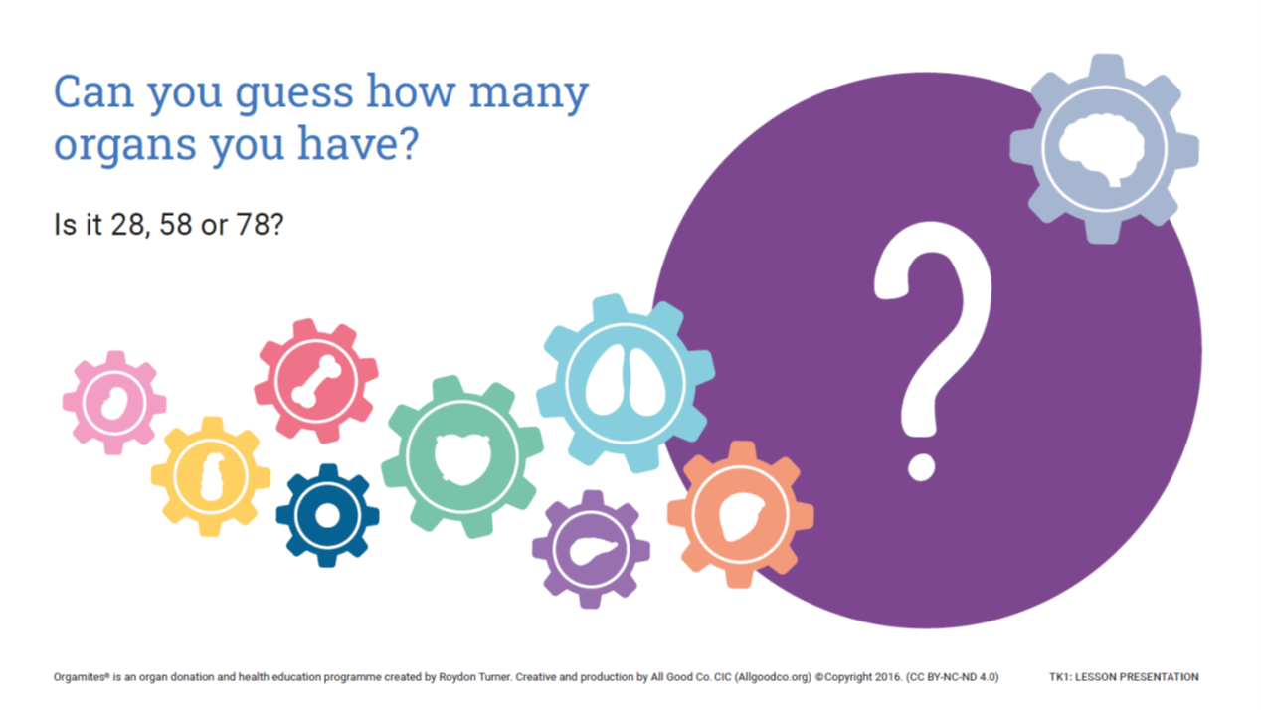

Slide 5
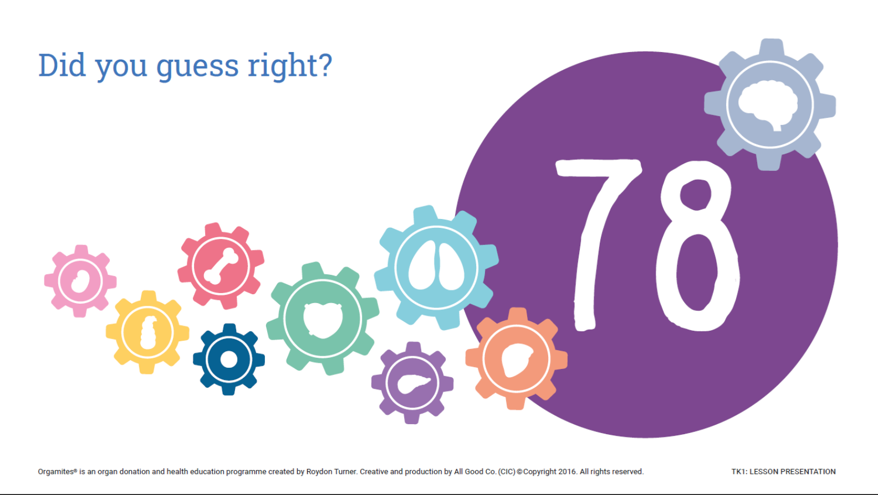

Slide 6
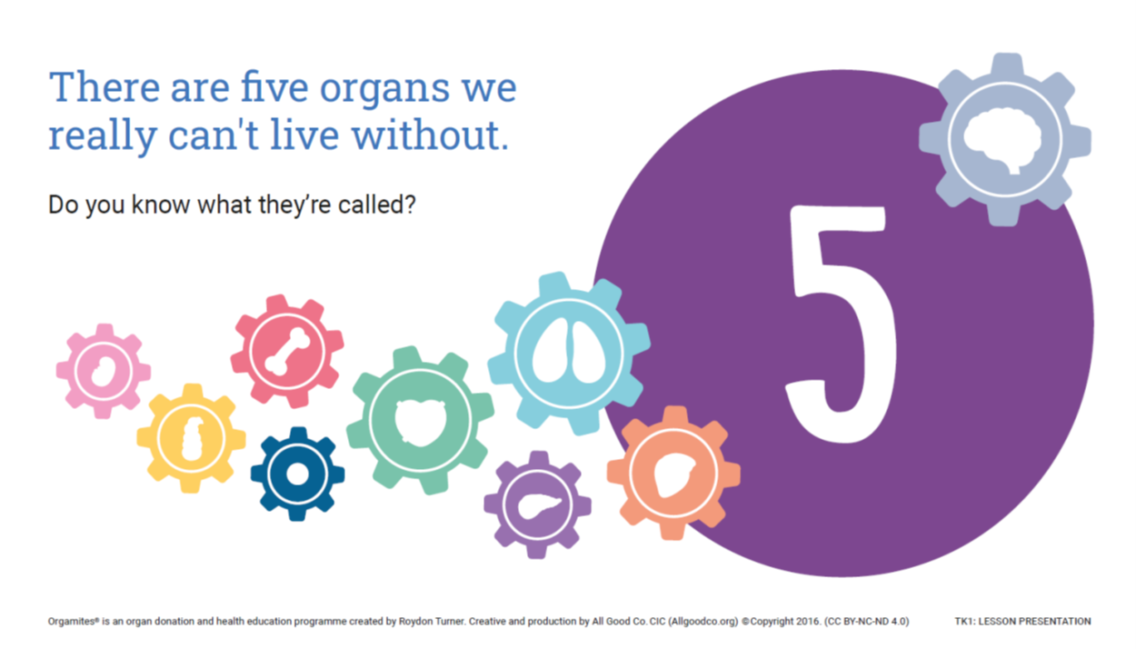
Did you know?

Slide 7
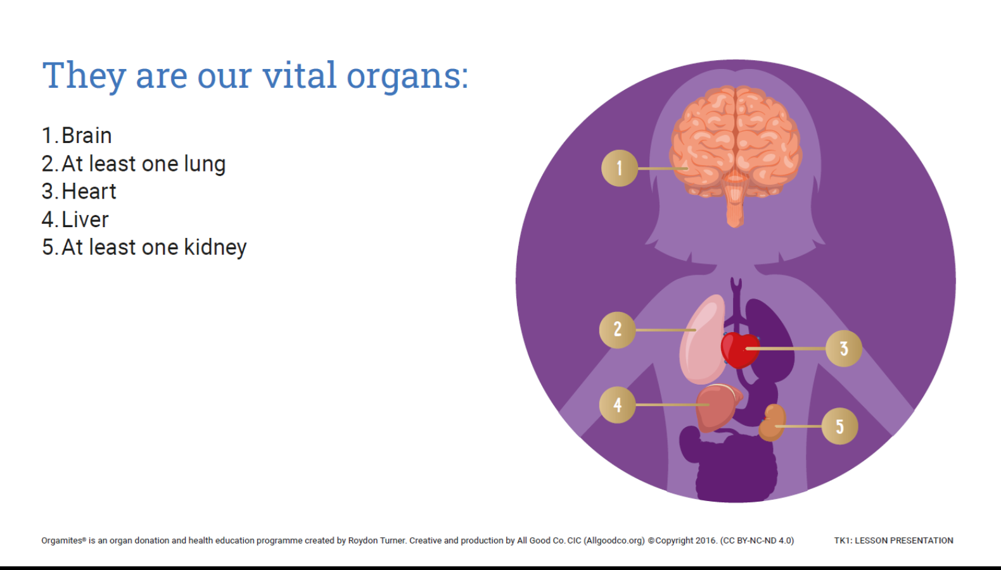

Slide 8
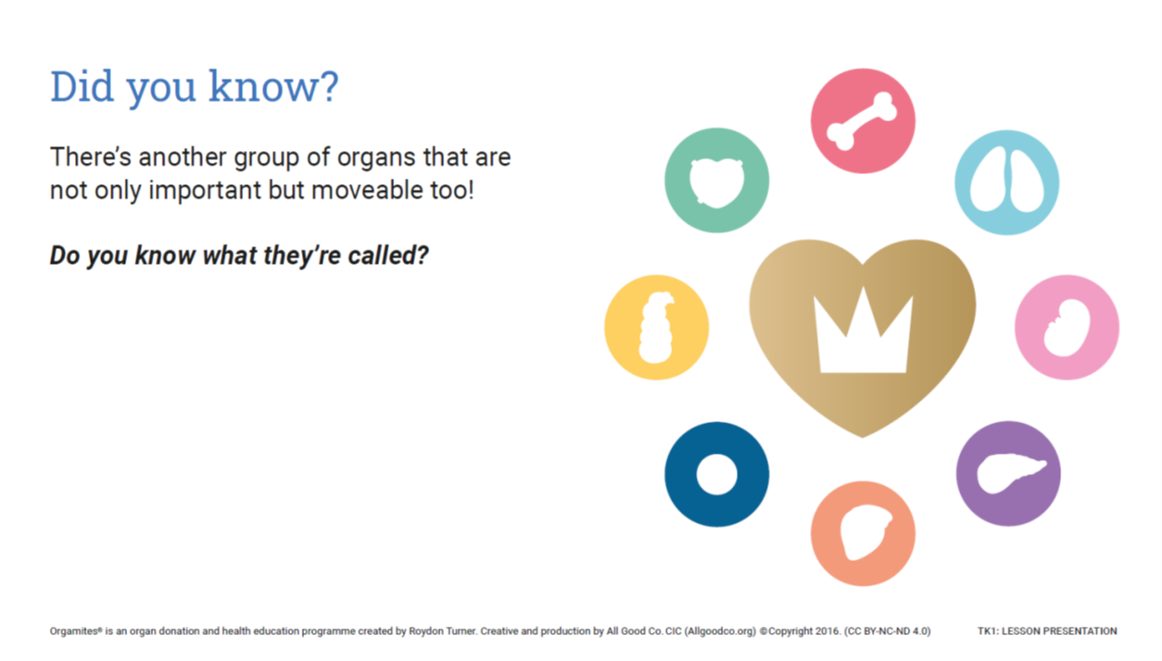

Slide 9
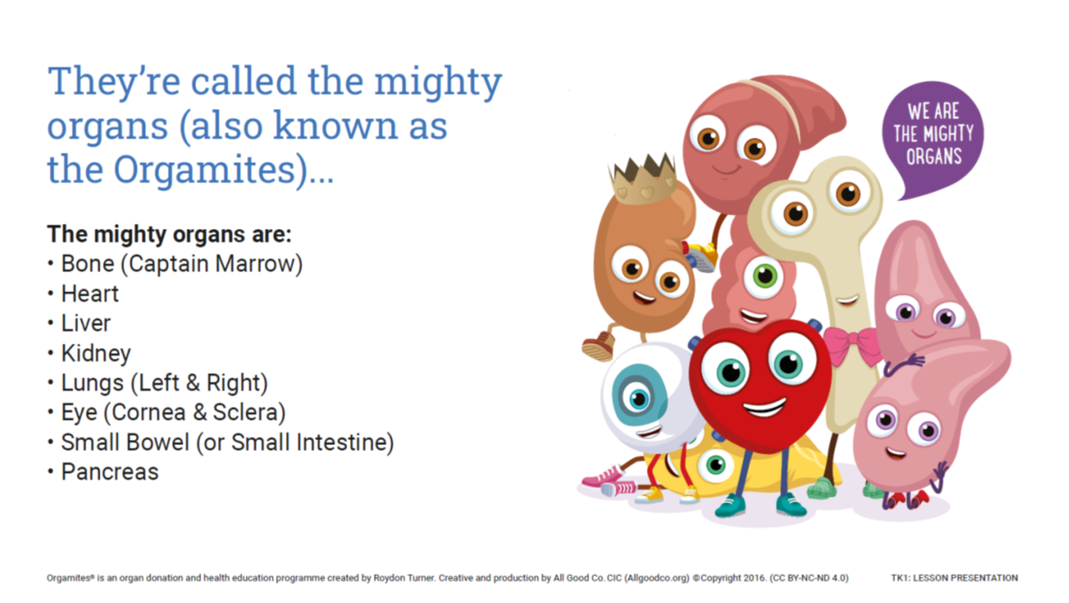

Slide 10
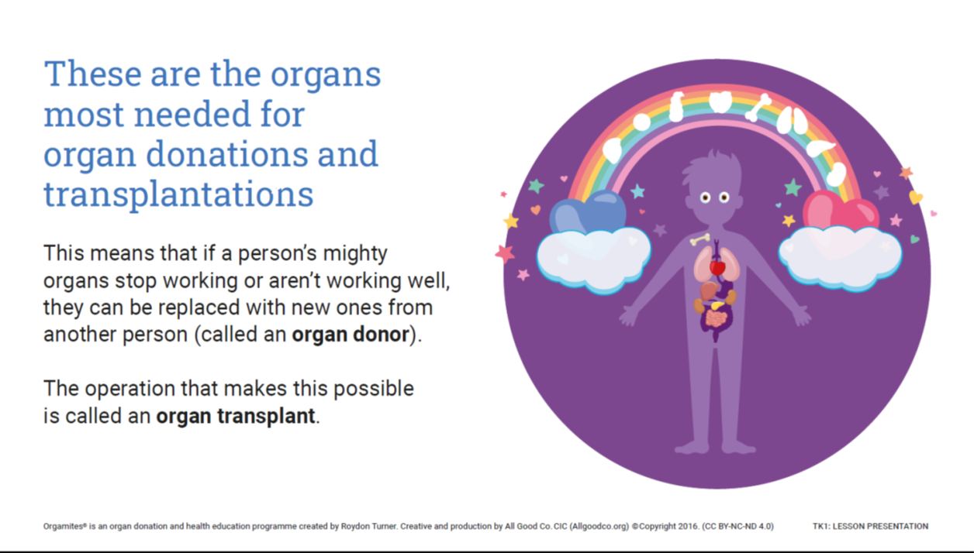

Slide 11
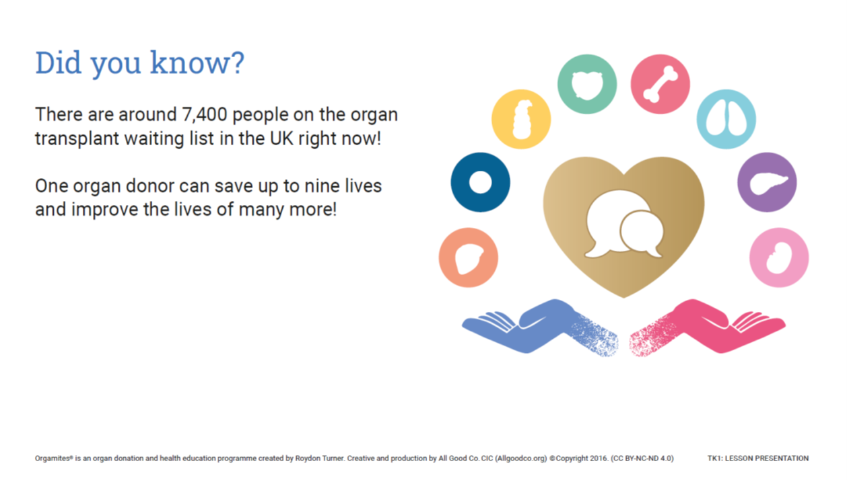

Slide 12
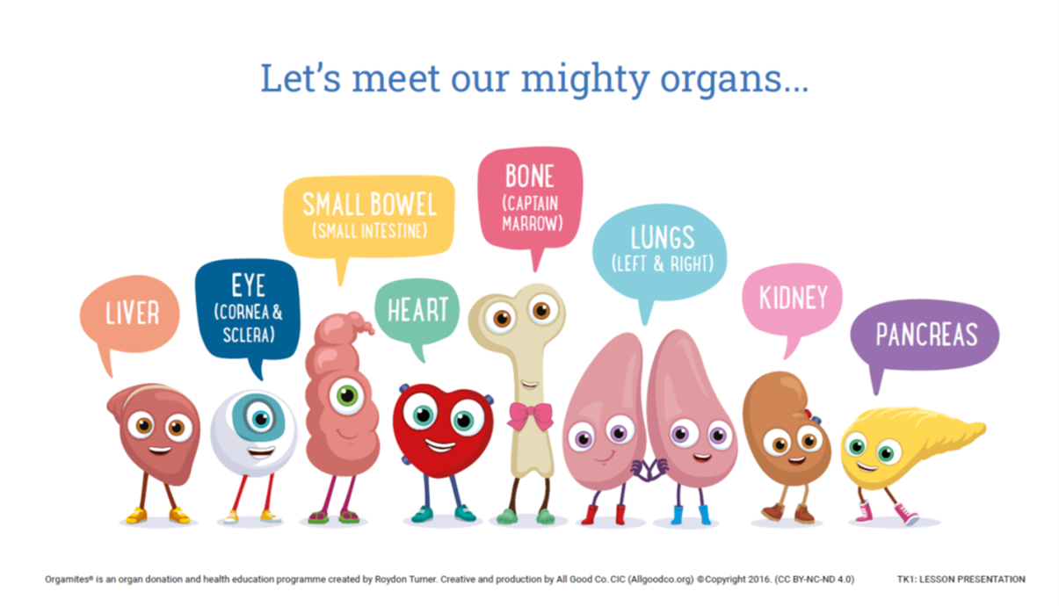


Slide 13
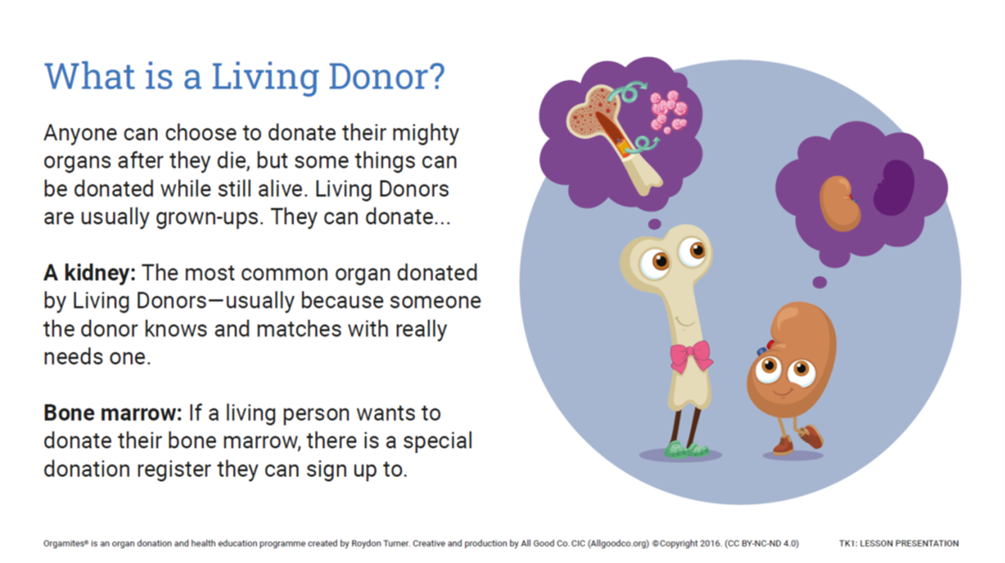

Slide 14
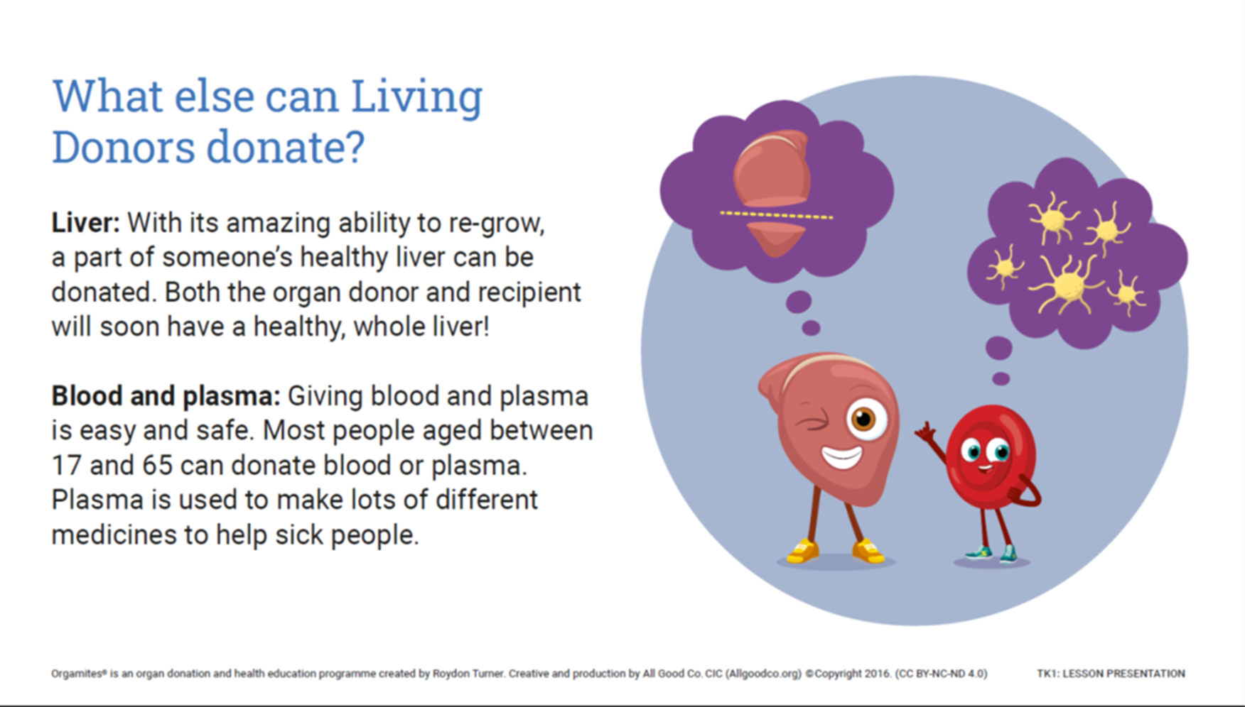

Slide 15
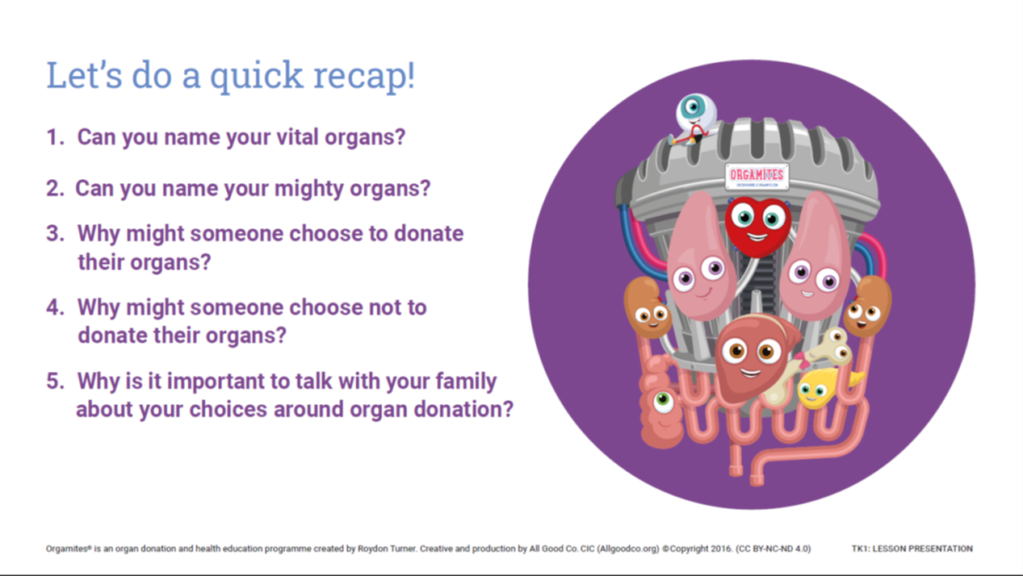
Quiz

Slide 16

Your mission
Your I.M.P.S. Mission this month is to talk to your family about how important organ donation is.
Find out how many grown ups in your family are organ donors. (if they are unsure, they can check it on the NHS app and your teacher has the details about how to do this)*
*Teachers, you can find this out from the monthly email sent with this presentation.

Slide 17

Mission ideas
As a group, make a list of 6 questions for the adults to answer.
e.g.
Question 1. Do you know how many people can be saved if you donate your organs?
Question 2. Are you an organ donor?
Make a pie or bar chart showing the results from your questions.

Slide 18
Remember
Being an organ donor could save up to 9 lives.

Slide 19

Thank you
Don’t forget to let I.M.P.S. know all about your missions!

Slide 20


