Slide 1

Playing safely outdoors
Will you help I.M.P.S. to keep your younger brothers and sisters safe?
#safetoys

Slide 2

Welcome to the I.M.P.S. team!
Now you are in year 6 you automatically become a member of the I.M.P.S. team!
I.M.P.S. is a special programme that teaches you how to be responsible for the risks you take and how to make them safer. It also teaches you what to do in an emergency.
Every month we are going to give you an I.M.P.S. mission to complete. We would love it if you let us know what you do at your school and send us some images.
Find out more about I.M.P.S. at www.impsweb.co.uk Your teacher will do some lessons with you and book a visit with our I.M.P.S. trainers to teach you lots of useful emergency skills.

Slide 3
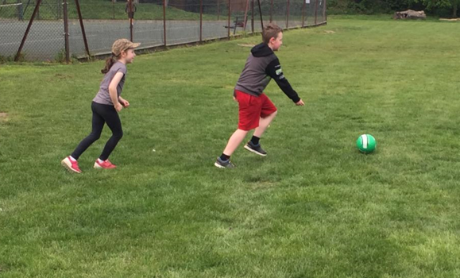

Playing safely outdoors
The summer is coming and we are all going to be spending lots more time outdoors.
It is important that you keep yourself safe while having fun, as having an injury is no fun at all!

Slide 4
Think about the places you play outdoors and make a list of them.
Park
Garden
Woods
Street
Playground
Down by the river/canal
Garden
Fields
Waste ground
Local wild area/nature reserve
Can you think of any other places you might play?

Slide 5
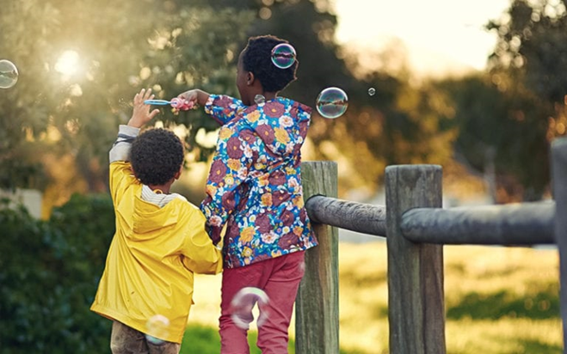
Now think about how you get to your play area.
Do you have to cross a road?
Do you walk there alone?
Are you in a group?
Do you cycle?

Slide 6
What sort of dangers might you find in your play area?
Electricity pylons
Deep water
Broken bottles
Syringes and needles
Broken play equipment
Dogs
Tripping hazards
Moving objects (swings)
Poisonous plants
Plants with stings or thorns
Litter

Slide 7
Just something to think about
Are there some places you should NEVER play?
Here are a few of our ideas.
Near overhead electricity pylons or an electricity substation
Near a weir or fast flowing water
On a building site
In a disused/empty building
On or near a busy road
Near a railway line or level crossing
Discuss why these places are dangerous.

Slide 8
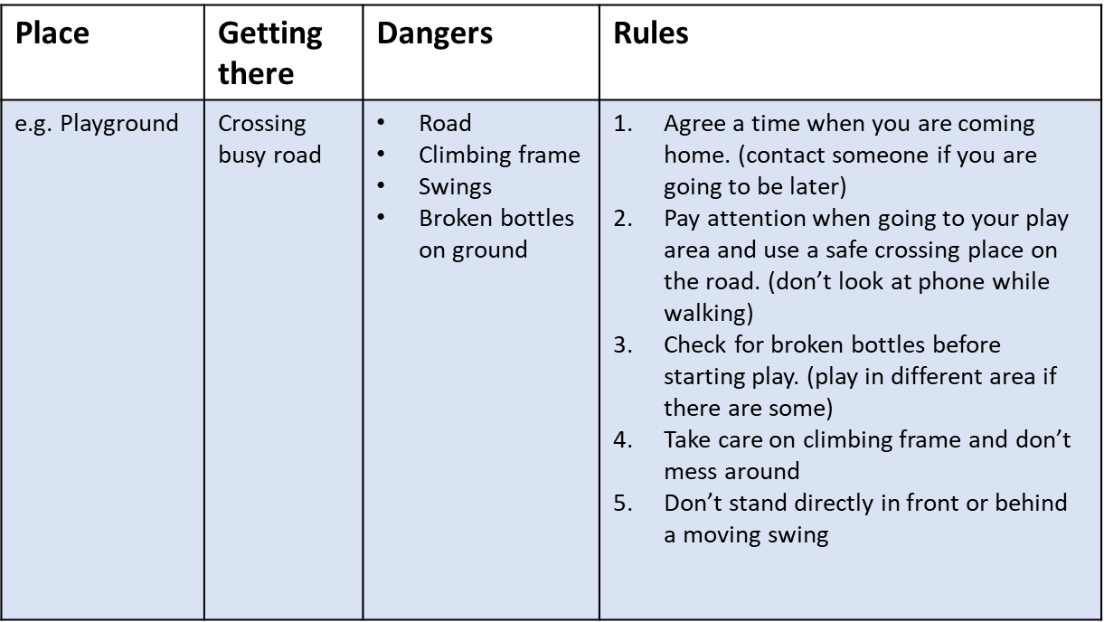
Set yourself some rules
Choose 2 of the places you play outdoors and fill in a chart. We have filled in an example for you to follow.

Slide 9

Your mission
Imagine you are an adult
What advice will you give a 10 year old child about playing outdoors?
Decide in groups how you are going to present your advice to other children and their parents and carers. (there are some ideas on the next slide)

Slide 10
Mission ideas
Poster
Booklet/leaflet
Write a rap or a poem
In a list
PowerPoint presentation
A film
An assembly or play
We would love to hear about what you decide to do – please ask your teacher to contact imps@ouh.nhs.uk and we can put your ideas on our website to help other children and adults.

Slide 11
Just a few bits more
Remember you don’t need to join in if your friends are doing something you don’t feel comfortable with.
Always tell someone where you are.
Always use play equipment properly and don’t cause damage.
Don’t speak to strangers.
Play where it is safe – if you’re not sure you should be playing there then you probably shouldn’t!
Be considerate to others and the environment.

Slide 12
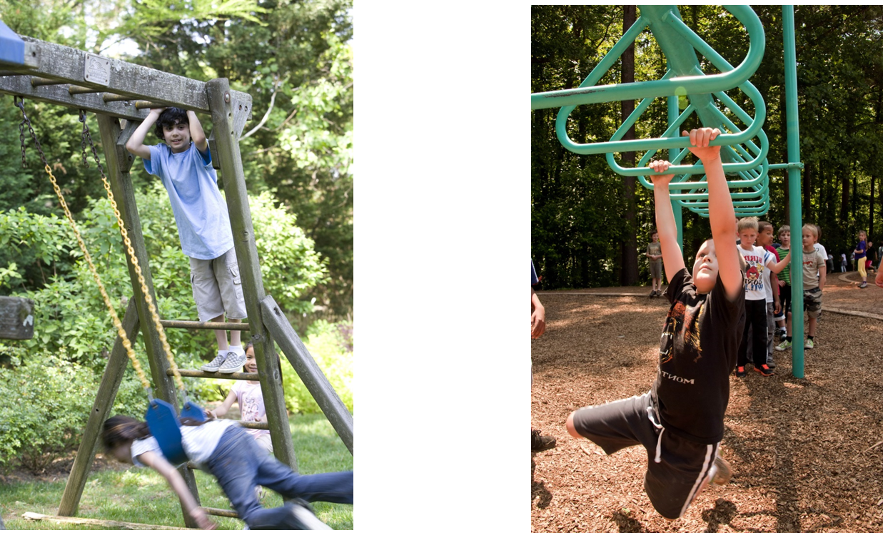

Thank you
Don’t forget to let I.M.P.S. know all about your missions!

Slide 13


