Slide 1
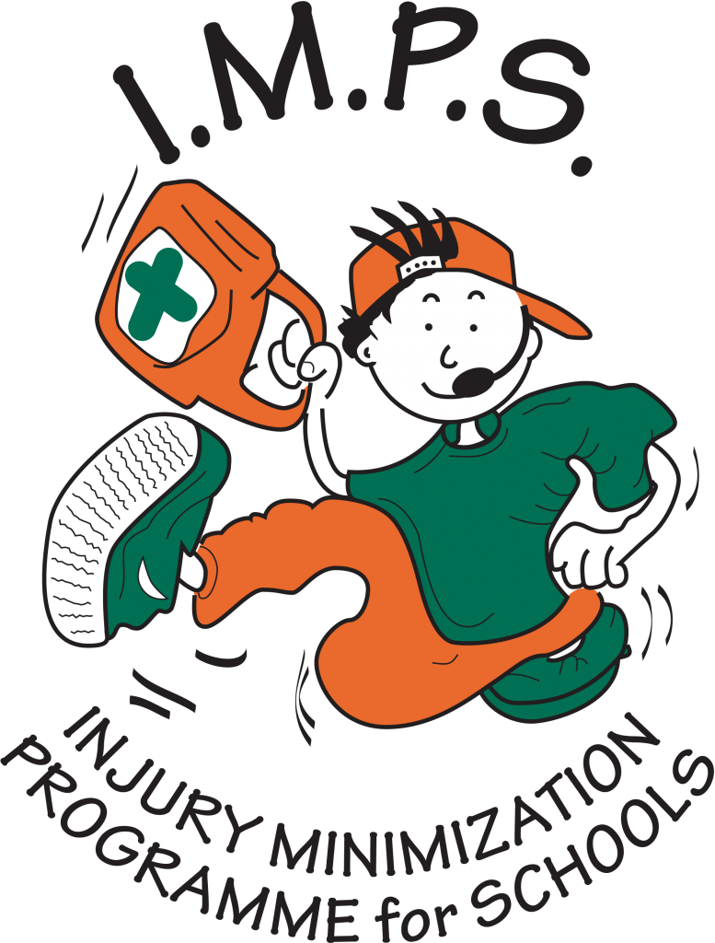
Injury Minimization Programme for Schools

Slide 2

Can you answer these questions about keeping safe near the railway?

Slide 3
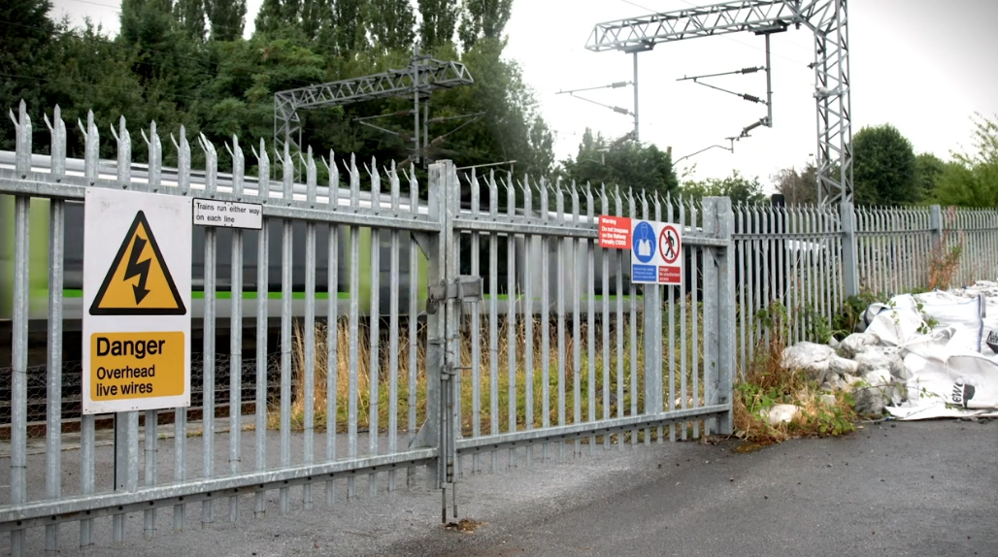
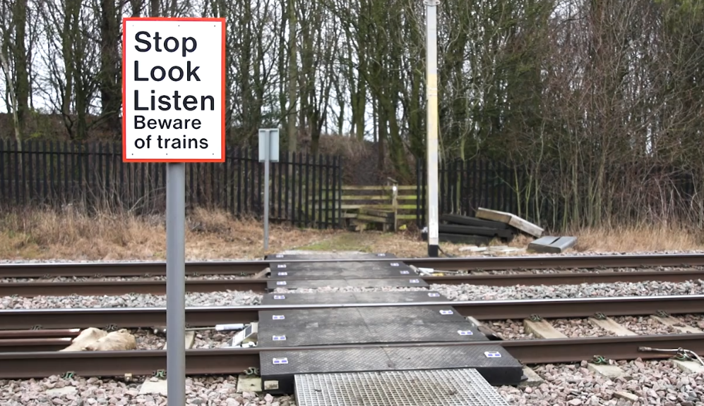
The tracks

Slide 4

When is it safe to take a short cut or
play on the railway tracks?
NEVER!
Always use a level crossing safely or cross the tracks using the bridge or underpass at a station.

Slide 5

How heavy is a train?
A train weighs 400 tons
That’s the size of 80 elephants!

Slide 6

How fast is a train?
A train can travel at 125 miles an hour.
It can cover the length of a football pitch in less than
2 seconds!

Slide 7
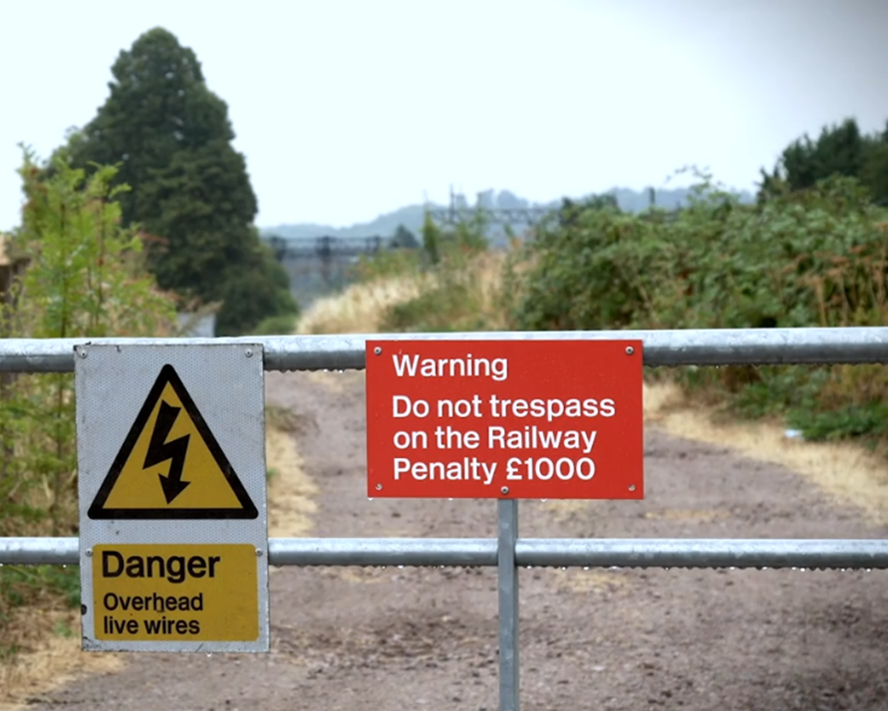
You are trespassing if you step on the railway tracks.
True or false?
True
It is illegal to step onto the railway tracks without permission and you can be fined £1000.
Never play on or near the tracks and never try to cross over them unless at a safe crossing place.
Modern trains are quiet and very fast and there is no time for you or the driver to react.

Slide 8
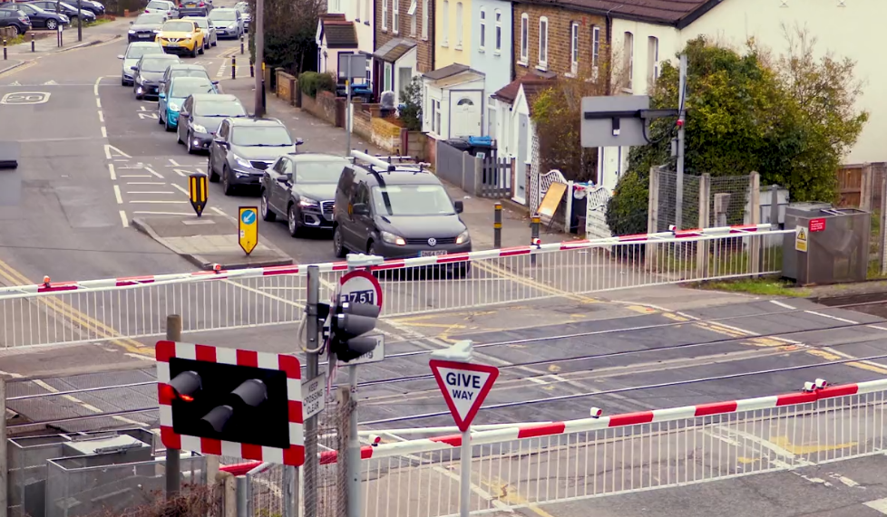
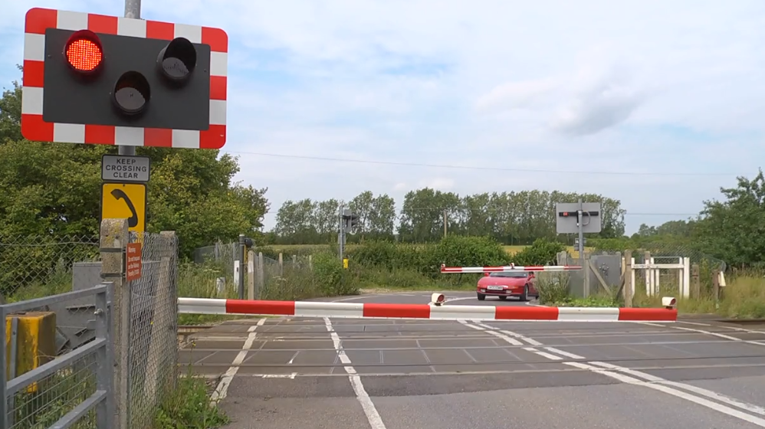
Level crossings

Slide 9
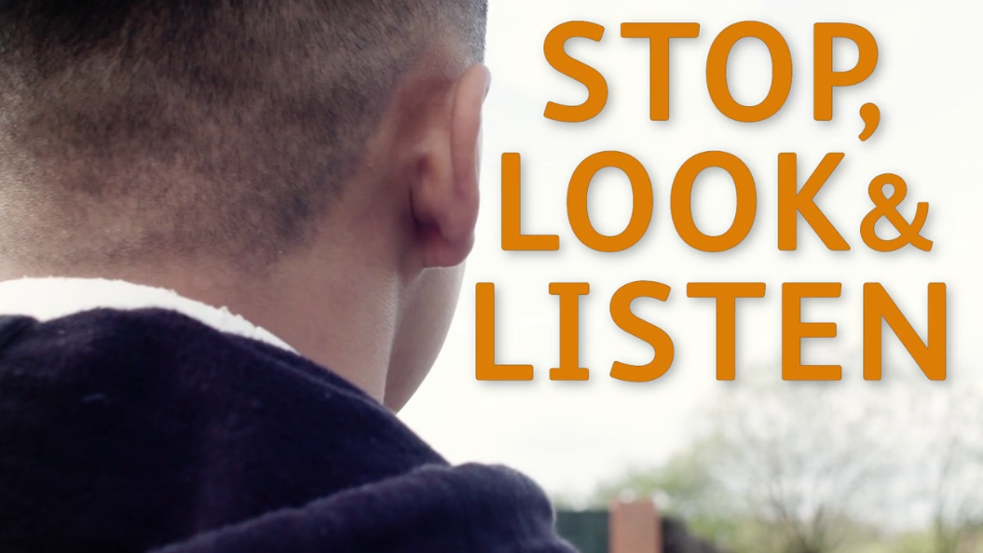
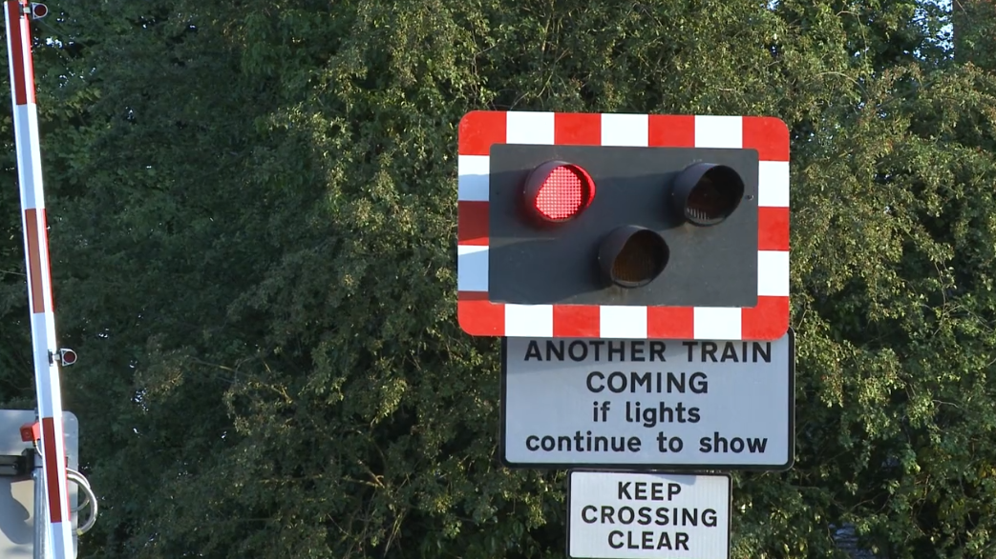
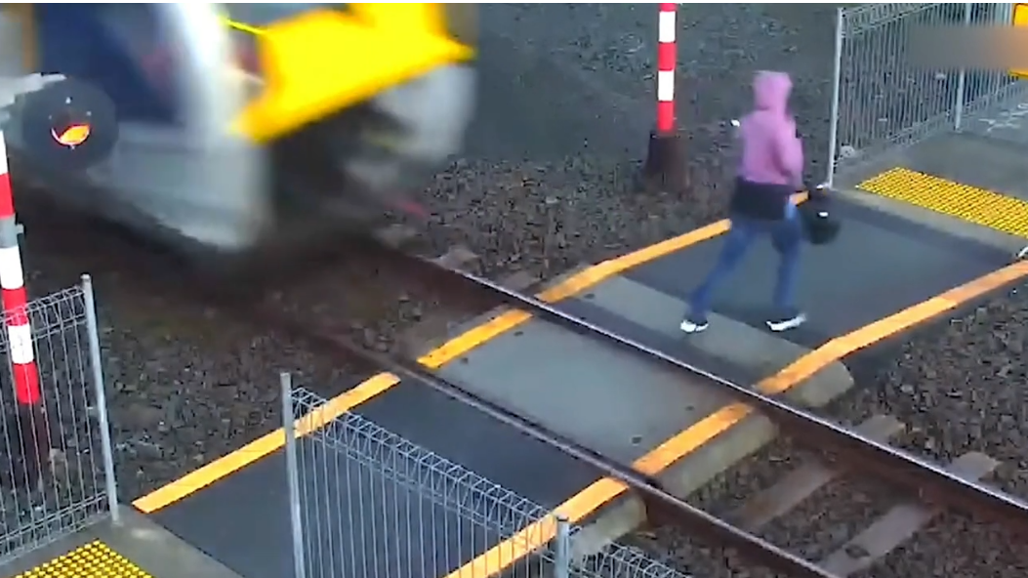

What should you remember about crossing at a level crossing?
Be alert
Never take risks
Follow the instructions

Slide 10
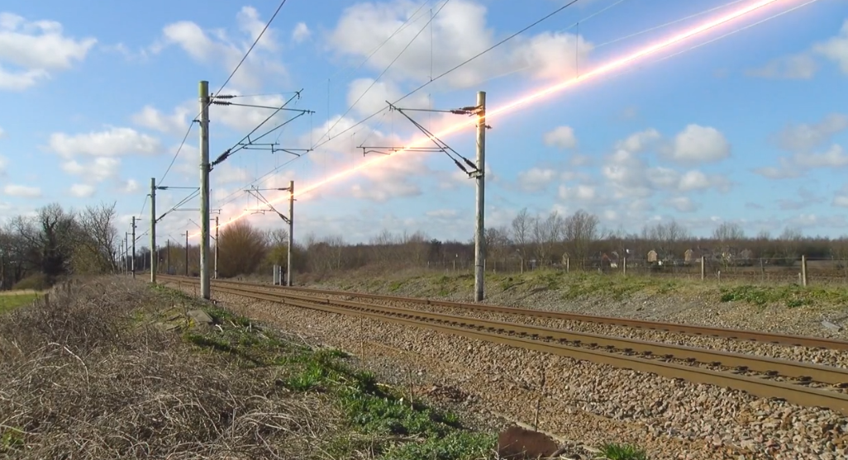
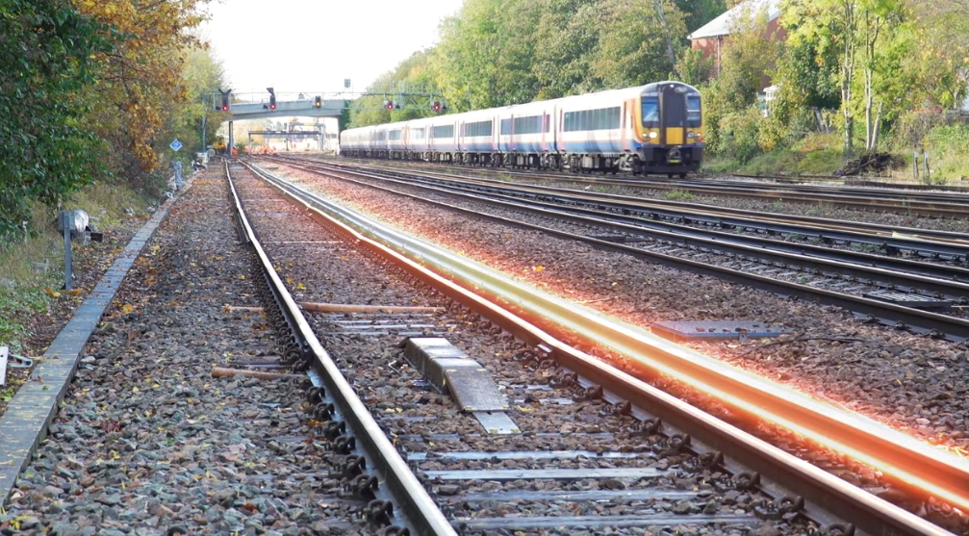
Electricity

Slide 11
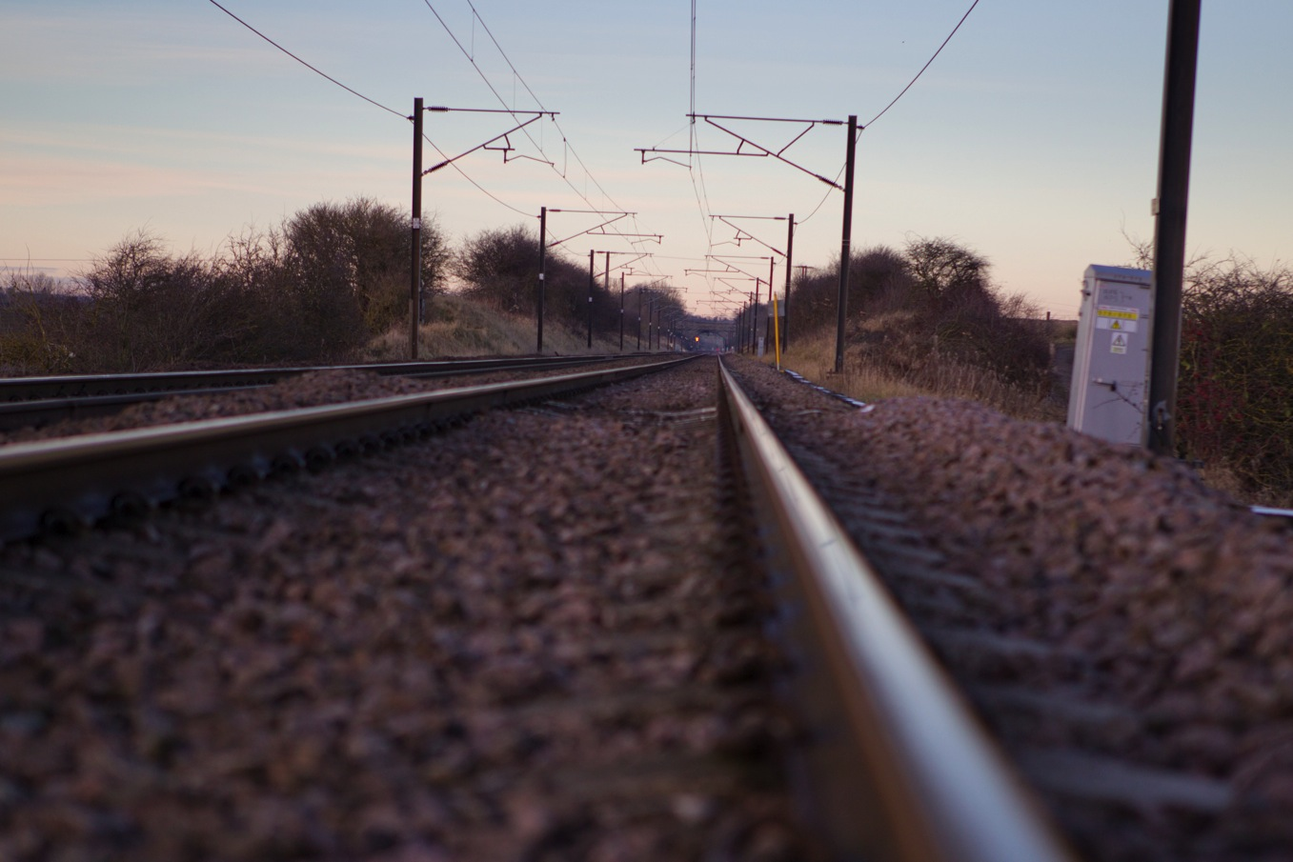

Spot the hazard
SIGNALLING LOCATION CASE
650 volts
OVERHEAD
LINES
25,000 volts
ELECTRICITY CAN ‘JUMP’
3 METRES!
BURIED
CABLE
25,000
volts
3rd RAIL
750 volts

Slide 12
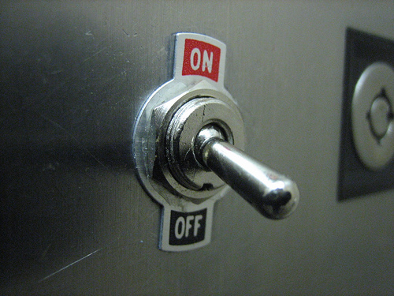
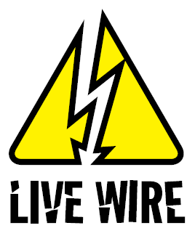
When are overhead lines & conductor rails switched off?
A. After the train has gone past
B. Overnight
C. Never – the electricity
is on all the time

Slide 13





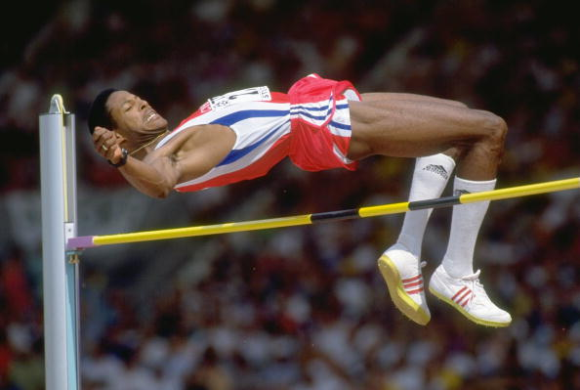
Electricity in overhead lines can ‘jump’– but how far?
A. Two metres - taller than an average man
C. Five metres - as high as a giraffe
B. Three metres - higher than the high-jump world record

Slide 14
Railway electricity is 100 times more powerful than electricity in the home.
True or false?
True
The railway is full of hidden dangers, one of which is electricity. The third rail has 750 volts passing through it and overhead line electricity carries 25,000 volts of electricity, both of them are always turned on – 24 hours a day, 7 days a week.

Slide 15
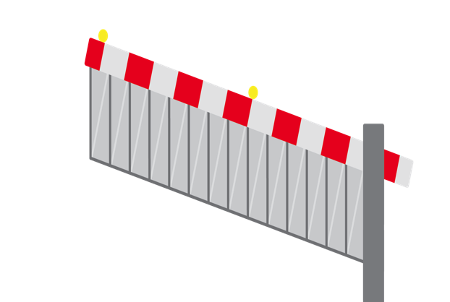

Stay safe around the railway
Electric lines and tracks are always on and can always kill.
Remember the Rail Life ‘Safety Top 3’
Stay clear of the tracks.
Is it worth putting
your life on the line?
Use the level crossing.
Shortcuts across the railway can kill
Know the signs.
Be alert to railway signs, they could save your life
Don’t play with kites
or balloons near overhead lines
Electricity can jump up to three metres.

Slide 16
Thank you
Stay safe
Thank you to Network Rail for the safety information and some of the slides.

