Slide 1
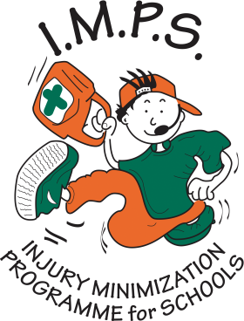
Recovery Position

Slide 2

Welcome to the I.M.P.S. team!
Now you are in year 6 you automatically become a member of the I.M.P.S. team!
I.M.P.S. is a special programme that teaches you how to be responsible for the risks you take and how to make them safer. It also teaches you what to do in an emergency.
Every month we are going to give you an I.M.P.S. mission to complete. We would love it if you let us know what you do at your school and send us some images.
Find out more about I.M.P.S. at www.impsweb.co.uk Your teacher will do some lessons with you and book a visit from our I.M.P.S. trainers to teach you lots of useful emergency skills.

Slide 3

The Recovery Position. Why?
If a person is unconscious but is breathing and has no other life-threatening conditions, they should be placed in the recovery position.
How do you know if someone is unconscious?
When they are unconscious, they are lacking awareness of their surroundings. They are unable to respond to other people.
They cannot move their body as all their muscles are floppy.
It is as if they are deeply asleep and unable to wake up. An unconscious person can sometimes hear what is being said to them.

Slide 4
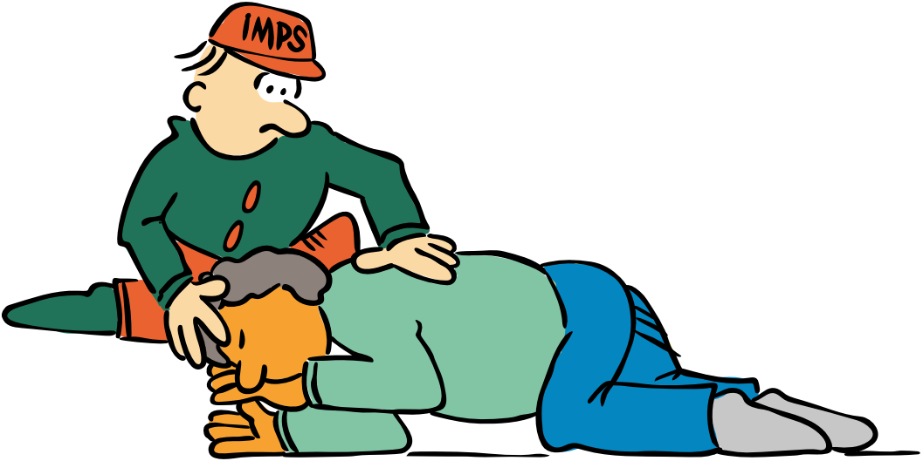
The Recovery Position: Why?
Putting someone in the recovery position will ensure their airway remains clear and open. It also ensures that any vomit or fluid will not cause them to choke.

Slide 5
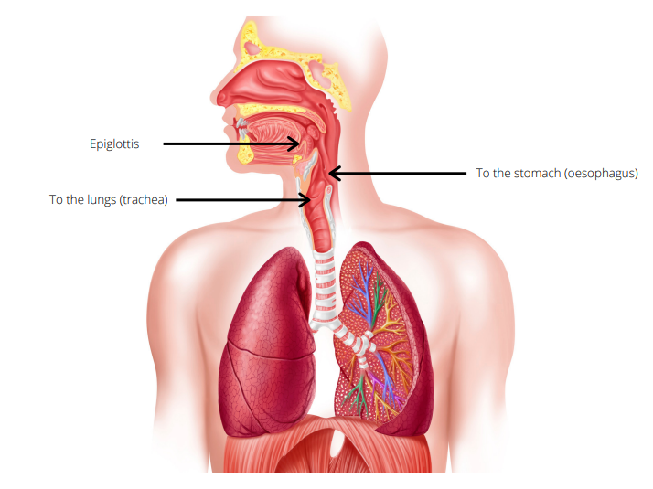
The airway
The airway is a tube that runs from your nose and mouth down into the lungs.
The air that we breath goes down our airway.
If someone is unconscious all their muscles go floppy.
The tongue is a big muscle and it may flop backwards and block the airway.
If this happens a person will stop breathing in a few minutes.

Slide 6
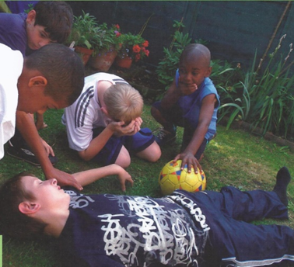
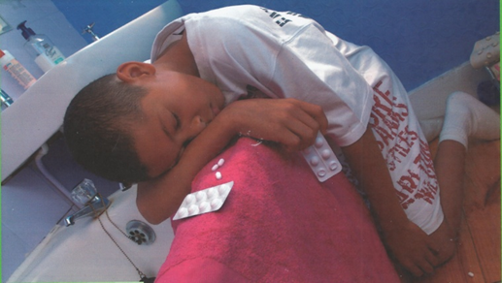
The recovery position: When?
There are many reasons a person might become unconscious.
How many can you think of?
They may have hit their head
They may have drunk too much alcohol
They may have fainted
They may have taken drugs
They may have a medical condition e.g. heart problems or diabetes.

Slide 7
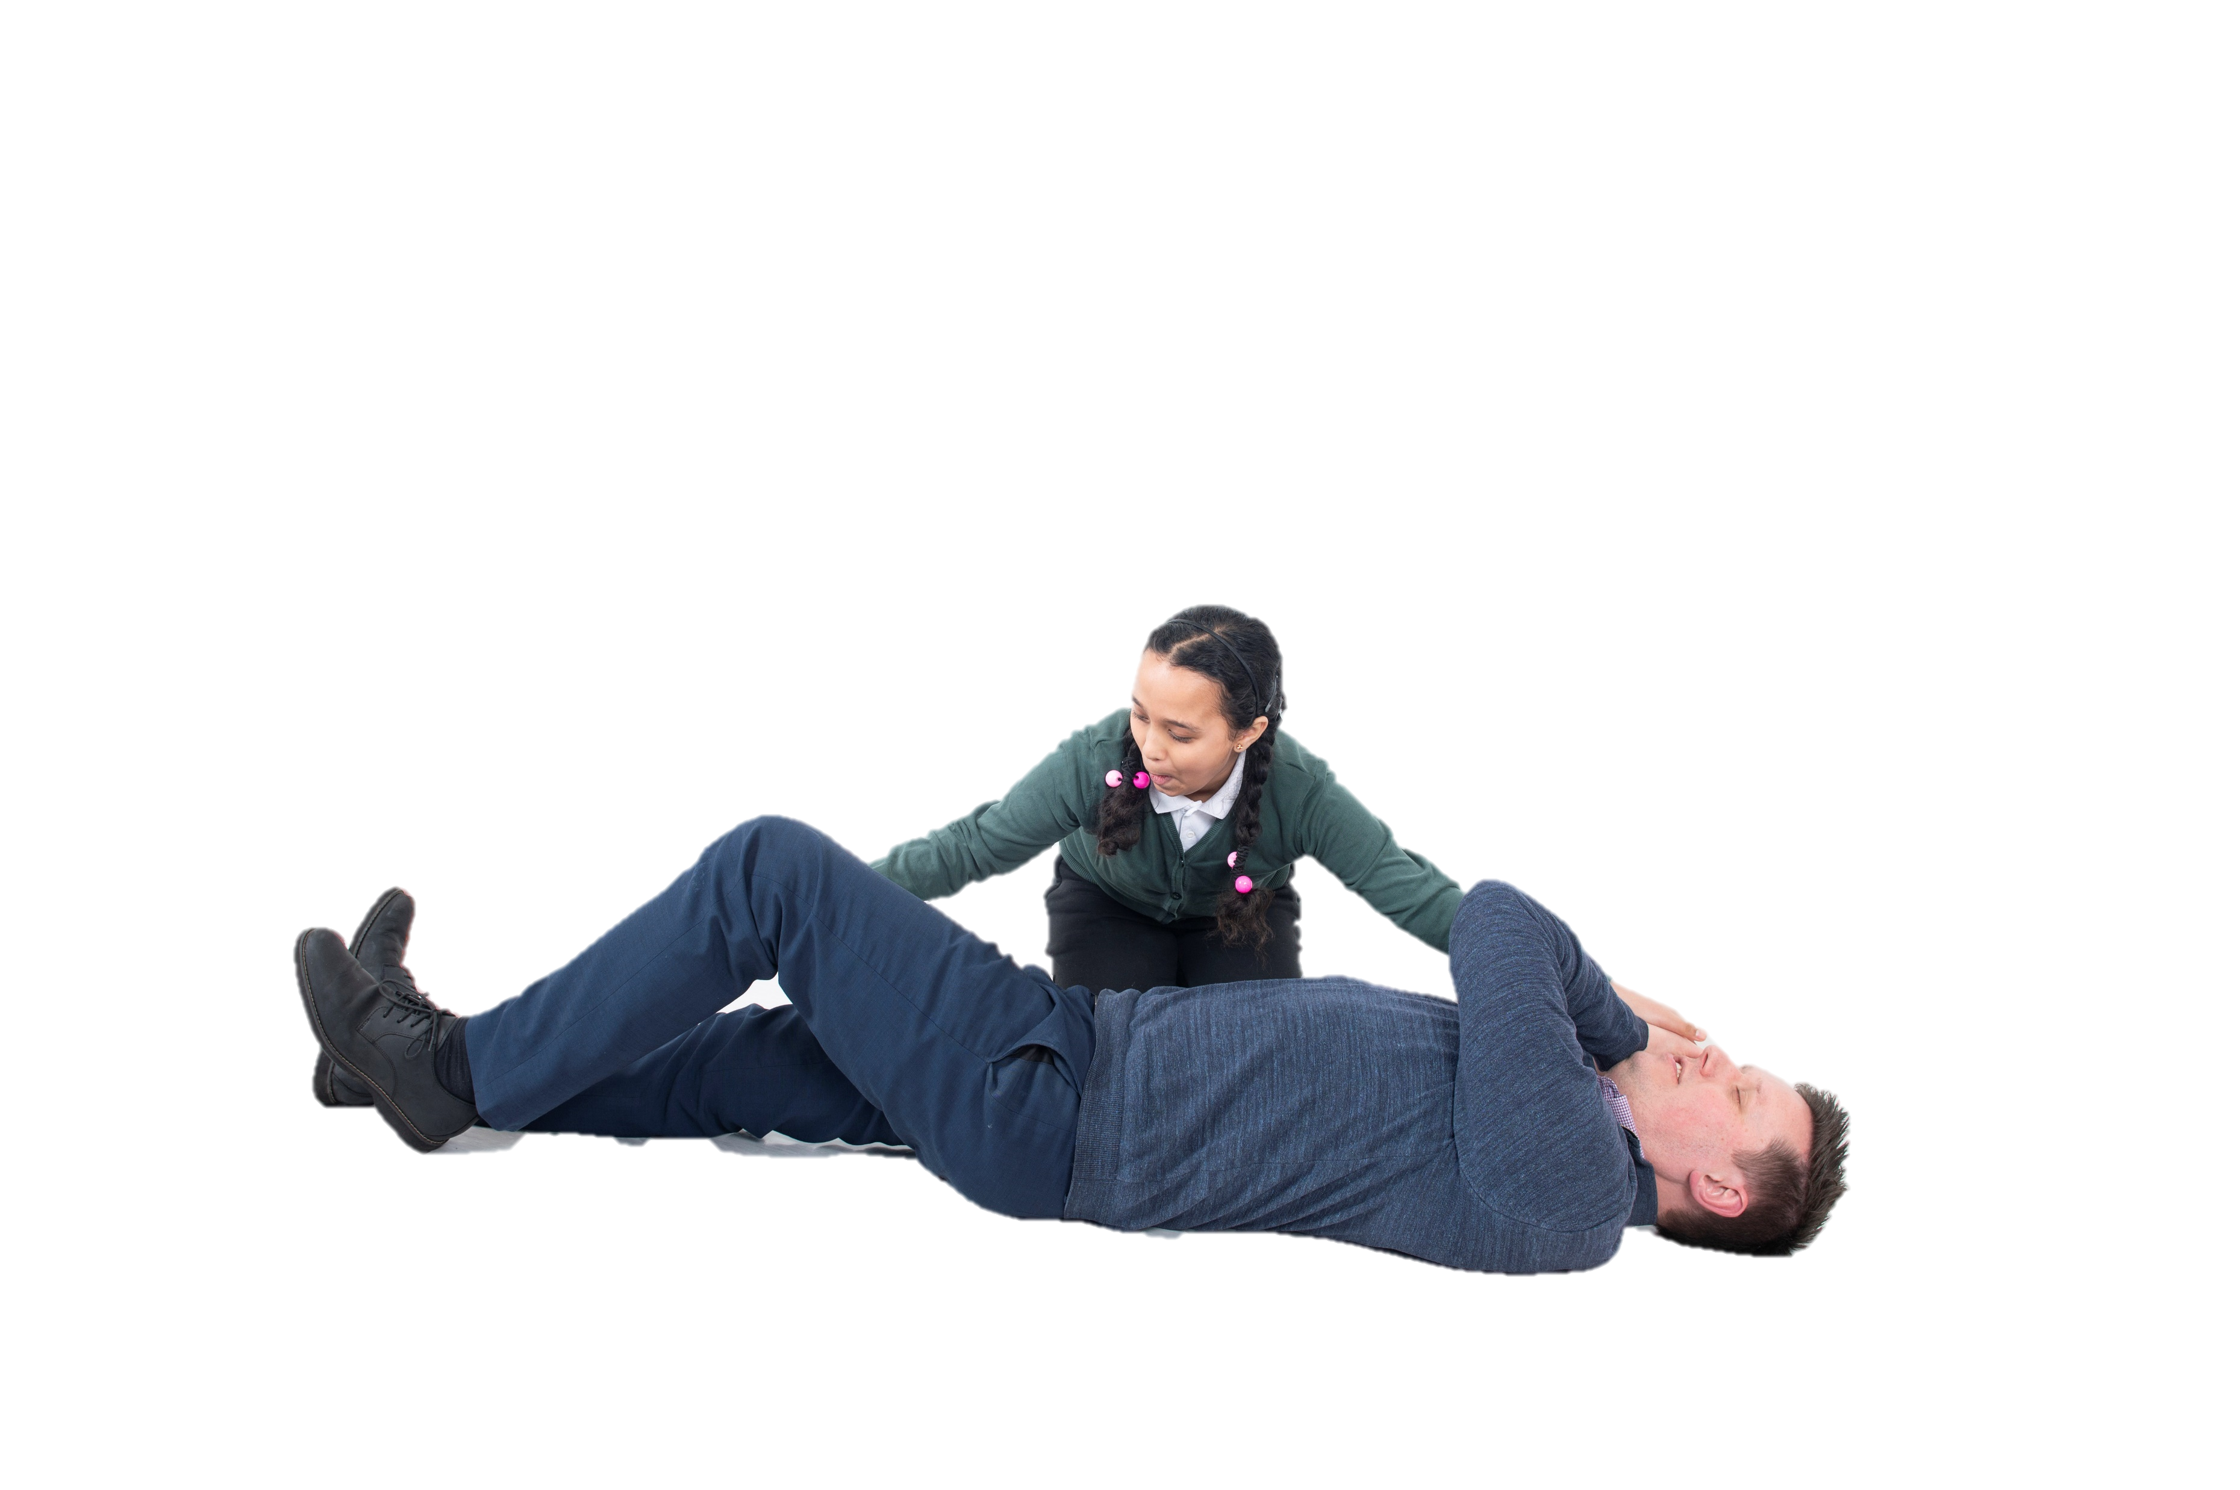
Recovery position: How?
It’s all done with levers, so it is easy to put someone
in the recovery position even if they are much bigger than you are.
We show you how on the next slide.

Slide 8
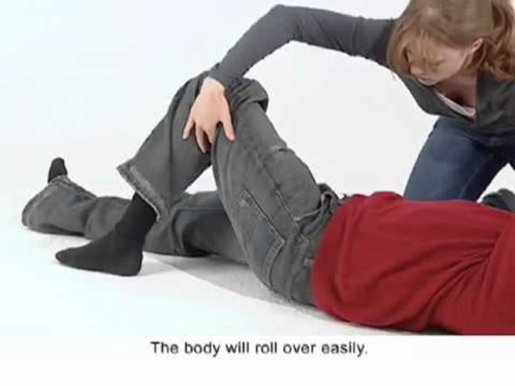
Recovery position: How?
It’s much easier to watch a film to see how to do it.
Click here or on the image to play.
The link directs you to a British Red Cross YouTube video which is linked from within the I.M.P.S. website

Slide 9
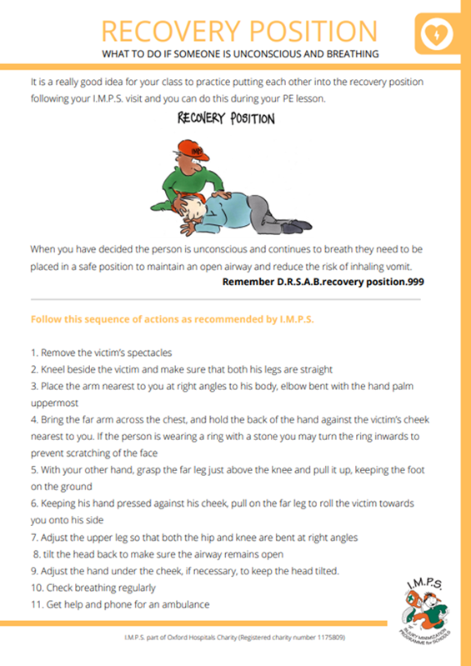
Recovery position
Your teacher can download an information sheet from our website.
You can use this to practice the recovery position on each other.

Slide 10
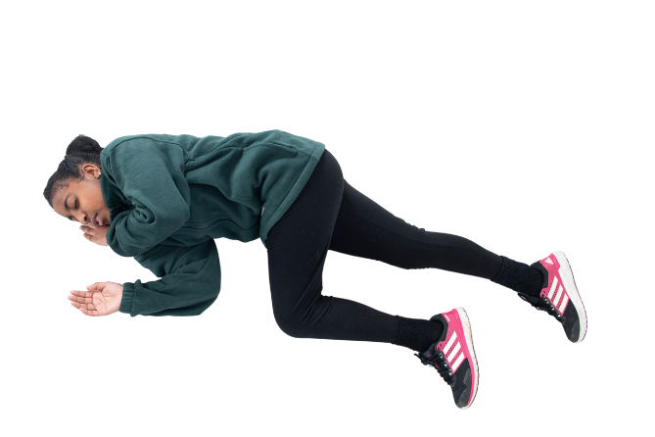
Remember.
Use the recovery position instructions to practice but if you can’t remember all the steps, just:
Move them onto their side and tilt their head back to open their airway.

Slide 11
Quiz
When do you put someone in the recovery position?
If a person is unconscious and breathing.
Why do you put someone in the recovery position?
To protect their airway and prevent it from being blocked by the tongue or vomit.
How do you put someone in the recovery position?
Lie them on their side with their head tilted back. (listen to check they are still breathing)

Slide 12

Your mission
This month your mission is to practise the recovery position on each other.
We would like you to teach other people how to do the recovery position by taking part in the recovery position challenge.
You can download instructions and a certificate here.
Make up some plays about when you need to use the recovery position and perform one in assembly.

Slide 13

Mission ideas
Watch the film about how to do the recovery position.
Practise the recovery position (it’s a fun cool down activity after PE.)
Go home and practise on someone who is bigger than you.
Show everyone at home how to put someone in the recovery position.
Keep a record of everyone you show and see who can teach the most people!
Let I.M.P.S. know what you have been doing.

Slide 14
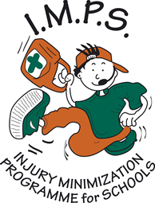
Thank you
Don’t forget to let I.M.P.S. know all about your missions!

Slide 15


