Slide 1

Road Safety Week 2024

Slide 2

Welcome to the I.M.P.S. team!
Now you are in year 6 you automatically become a member of the I.M.P.S. team!
I.M.P.S. is a special programme that teaches you how to be responsible for the risks you take and how to make them safer. It also teaches you what to do in an emergency.
Every month we are going to give you an I.M.P.S. mission to complete. We would love it if you let us know what you do at your school and send us some images.
Find out more about I.M.P.S. at www.impsweb.co.uk Your teacher will do some lessons with you and book a visit from our I.M.P.S. trainers to teach you lots of useful emergency skills.

Slide 3


Road Safety Week November 17th – 23rd 2024.
After the crash.
Who cares for someone after a crash, and who helps us make safe, healthy journeys?
How can we all use roads safely to protect ourselves and each other?
How can we ask others to help keep us safe near roads?

Slide 4
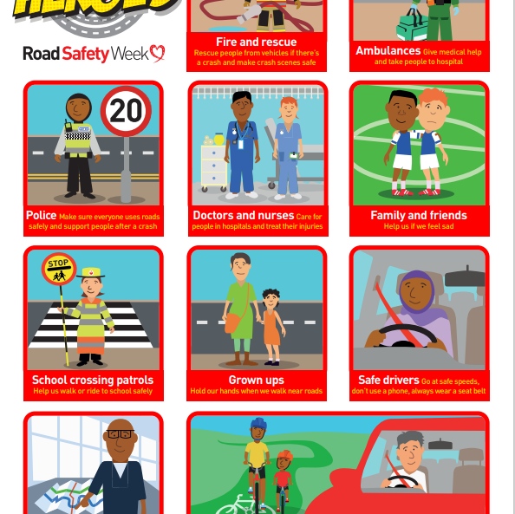
Who is a road safety hero?
We think that everyone who helps make journeys safer and healthier or cares for people after a crash is a road safety hero.
In groups or as a class write down a list of who you think is a road safety hero.

Slide 5
Road safety heroes.
These people help us after a crash.
Fire and rescue services
Ambulance services
Medical staff in hospitals
Other health professionals
Police family liaison officers
Support services
These people help us make safe and healthy journeys.
Parents and carers
School crossing patrols
Roads policing officers
Road designers and highway engineers
Everyone who uses roads safely to protect themselves and others

Slide 6

Road safety heroes
In groups of 2 or 3, chose one Road Safety Hero and talk about what they do to help after a crash or to keep us safe on the roads.
Note to teachers. Information can be found here on the BRAKE website or downloaded from the Mailchimp lesson.

Slide 7


Select a local Road Safety Hero
You could choose:
Parents/carers who work for emergency services
Your local road safety officer
Your school crossing patrol
Someone who has campaigned for road safety for your school
Cycle trainer
Members of emergency services that you have invited to attend your assembly.

Slide 8

Write down why you have chosen your Road Safety Hero

Slide 9
Road safety facts.
More than 1.3 million people die on roads every year.
Road crashes are the leading cause of death for children and young people worldwide.
More than six children are killed or seriously injured on roads every day in the UK.
Pollution from traffic causes respiratory illnesses and other diseases.
Active travel such as walking and cycling is good for the nation’s health and good for the planet.

Slide 10

Did you know?
5 people die on UK roads every day.
It takes 23 metres for a car to stop if it is travelling at 30 miles an hour.
The speed limit is the top speed you should travel on that road. (it doesn’t mean it is safe to drive at this speed in all conditions)

Slide 11
Quiz
What is the speed limit on the road outside your school?
How many people die each day in road traffic accidents?
5 people die every day
Should you always drive at the speed limit on all roads all the time?
No. The speed limit is the maximum speed you should travel. It is often safer to go slower especially in bad weather and when there are cyclists and pedestrians.
How many metres does it take to stop in a car travelling at 30 miles per hour?
It takes 23 metres for a car to stop when it is travelling at 30 miles an hour.

Slide 12
Your mission
Your mission this month is to think about how you can become a road safety hero by using the roads sensibly and encouraging others to do the same

Slide 13

Mission ideas
Remember that we all share a responsibility to use roads safely, and this includes people who walk, scoot and ride, as well as people who drive.
Decide not to use your phone when walking near roads/crossing roads
Play in safe places away from traffic.
Talk to your parents or carers and remind them to drive at safe speeds, especially in areas where people live, work and play; to never use their phone while driving; and to always wear a seat belt.
Make a display for your classroom.
Write a story about a road safety hero.
Explain to the younger children at school about how to behave around roads.

Slide 14

Thank you
Don’t forget to let I.M.P.S. know all about your missions!
(we would love to put them on our website and in our newsletters.)
www.impsweb.co.uk

Slide 15


