Slide 1
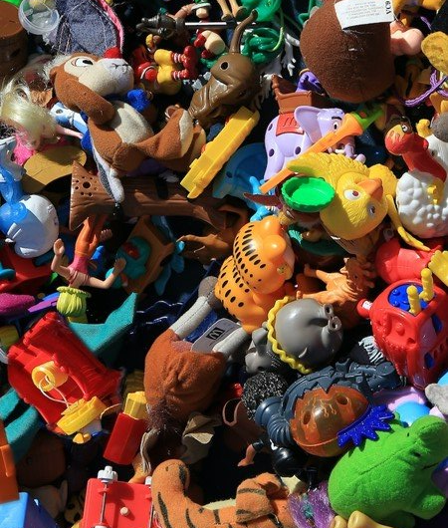

Safe toys
Will you help I.M.P.S. to keep your younger brothers and sisters safe?
#safetoys

Slide 2

Welcome to the I.M.P.S. team!
Now you are in year 6 you automatically become a member of the I.M.P.S. team!
I.M.P.S. is a special programme that teaches you how to be responsible for the risks you take and how to make them safer. It also teaches you what to do in an emergency.
Every month we are going to give you an I.M.P.S. mission to complete. We would love it if you let us know what you do at your school and send us some images.
Find out more about I.M.P.S. at www.impsweb.co.uk Your teacher will do some lessons with you and book a visit from our I.M.P.S. trainers to teach you lots of useful emergency skills.

Slide 3

What sort of toys can be dangerous and why?
Toys with small parts.
Toys with small button batteries.
Toys with long cords.
Toys with strong magnets.
Young children might choke on them.
If a button battery is swallowed it will burn through the child’s food pipe.(oesophagus)
Young children might get strangled with the cords.
If powerful magnets are swallowed, they can stick together and burn holes in a child’s gut.

Slide 4


Symbols #safetoys
Toys that are made in the UK and Europe have to comply to a high safety standard.
Some toys that are sold from an online market place will not have been made to the same safety standards and will be unsafe.
Look out for these safety marks on toys so you can be sure they are safe.
A Lion Mark shows that the toy has been made by a member of the British Toy and Hobby Association, to a high standard of safety and quality.
A CE mark is required by law on any toy sold in the EU. It is the manufacturer’s claim that the toy complies with European safety rules.

Slide 5

#safetoys
Do you know what this symbol means?

Slide 6


#safetoys
It shows that these toys aren’t suitable for children under 36 months (or 3 years old)
Babies and toddlers put nearly everything in their mouths, which is why some toys are marked with age restrictions, in case little ones choke on small parts or loose hair on soft toys.

Slide 7
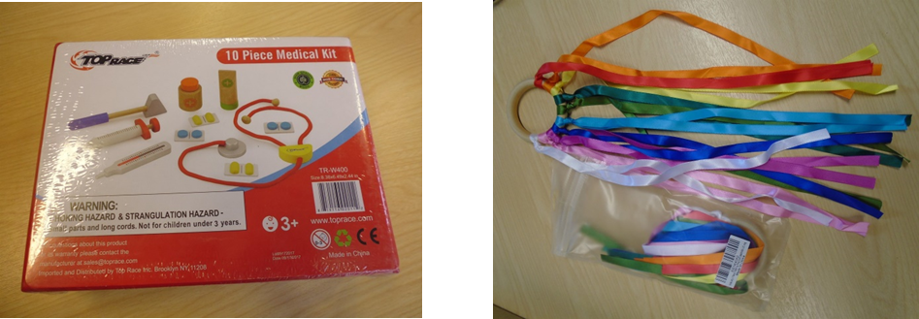
This can all sound very frightening! #safetoys
There are some very simple ways you can make sure that young children are safe with their toys.
Can you think of 3 ways?
There are some ideas on the next slide.

Slide 8
Remember #safetoys
Make sure that the toys are manufactured to a safe standard and show the Lion or CE mark.
Make sure that there are no small parts that a young child can choke on.
Make sure the toys are suitable for the age of the child.
Make sure that the toy doesn’t come apart easily to expose sharp spikes and nails.
Don’t keep broken toys.
Make sure the battery is contained safely in the toy.
Remember! Just because you can buy a toy – it doesn’t mean it is safe!

Slide 9
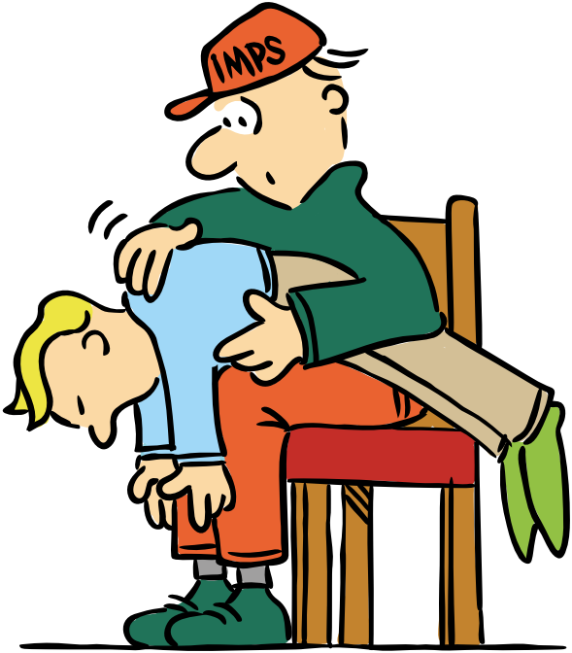
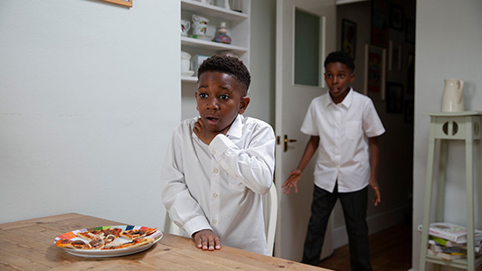
What to do if a child chokes #safetoys
If a small child chokes, put them over your knee so their head is lower than their body and give them 5 back blows between the shoulder blades. Repeat if the blockage is not dislodged.
Call 999 and follow the instructions given by the operator.
Watch a British Red Cross film about choking here. https://youtu.be/e9aoHLax1tw

Slide 10

Quiz #safetoys
What does this symbol mean?
What does this symbol mean?
A Lion Mark shows that the toy has been made by a member of the British Toy and Hobby Association, to a high standard of safety and quality.
The toy is not suitable for children under the age of 3 years
Why are toys with small parts dangerous?
Young children might choke on them.
What might happen to a young child if they swallow a button battery?
It will burn through a child’s food pipe (oesophagus) and could cause death.

Slide 11
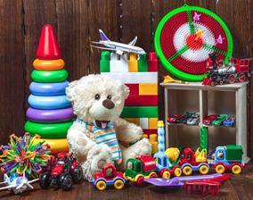

This month your mission is to help keep your brothers and sisters safe.
Your mission
Here are some things you can do to help keep your younger brothers and sisters safe especially at Christmas.
Remind the adults who are buying Christmas presents to look out for safe toys.
Check all the toys in your house for safety symbols.
Make sure that broken toys are not left in the toy box.
Keep unsuitable toys away from little ones.

Slide 12

Mission ideas
Make a poster or design an email for parents to remind them about #safetoys.
Keep the messages simple and clear.
Just use 3 messages.
Use images or drawings.

Slide 13

Thank you
Don’t forget to let I.M.P.S. know all about your missions!

Slide 14


