Slide 1


Screen time
Will you help I.M.P.S. to keep your younger brothers and sisters safe?
#safetoys

Slide 2
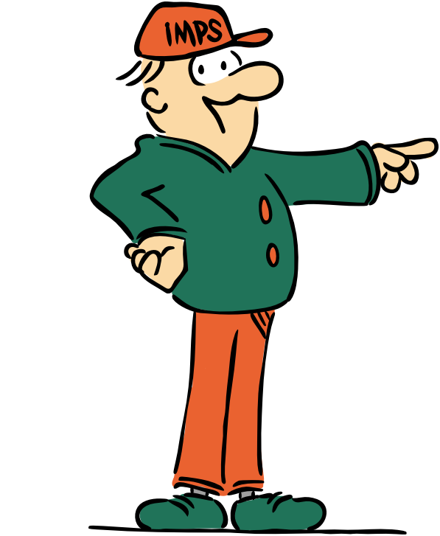
Welcome to the I.M.P.S. team!
Now you are in year 6 you automatically become a member of the I.M.P.S. team!
I.M.P.S. is a special programme that teaches you how to be responsible for the risks you take and how to make them safer. It also teaches you what to do in an emergency.
Every month we are going to give you an I.M.P.S. mission to complete. We would love it if you let us know what you do at your school and send us some images.
Find out more about I.M.P.S. at www.impsweb.co.uk Your teacher will do some lessons with you and book a visit from our I.M.P.S. trainers to teach you lots of useful emergency skills.

Slide 3
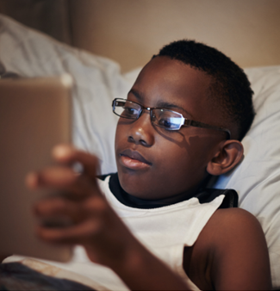

How much screen time?
Everyone is using screens more and more at the moment.
Do you think you use a screen too much? Lets find out….

Slide 4
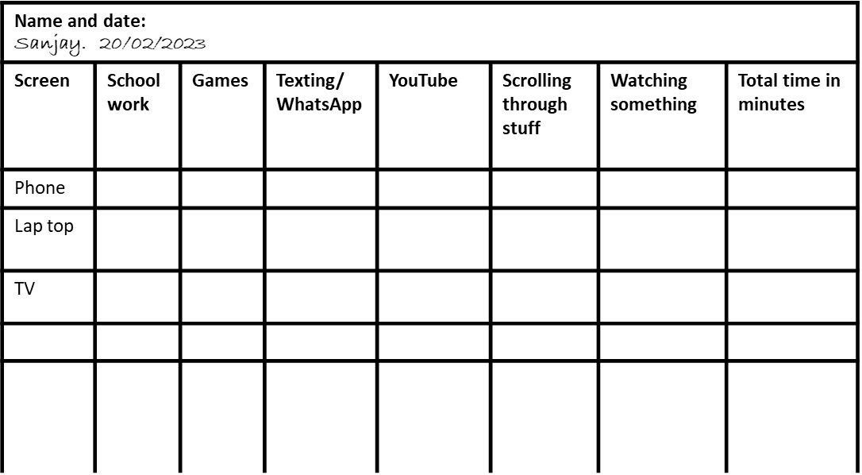
Survey
Make a table like this one, and list all your devices in the first column.
Fill in what you do on each device along the top row.
You might need to add more columns and rows to your table.
This is an example of what you could write in your rows and columns.
Fill in the times you spend on each device for one day
Have a look at the next slide to find out how to fill it in.

Slide 5
Adding your data
Start a stopwatch or make a note of the time when you start and finish using a device and record how long you use it for.
Fill in your table for one day like the one to the side.
You could ask everyone in your house to do the same for a day.
Name and date: Sanjay. 20/02/2023
Screen | School work | Games | Texting/ whatsapp | YouTube | Scrolling through stuff | Watching something | Total time in minutes
Phone |  |  | 60 | 90 | 30 |  | 180
Lap top | 120 | 60 |  |  |  |  | 180
TV |  |  |  |  |  | 90 | 90
Total |  |  |  |  |  |  | 450 minutes or 7 hours and 30 minutes
Make sure you put a column at the end so you can add up the total number of hours and minutes you spend on each device.

Slide 6

Results
Were you surprised how much time you spent looking at a screen in one day?
How much time would you spend in a week looking at a screen?
What is the daily average time you spend looking at each device?
What device did you use most?
How much time was spent doing something passively on the screen? (this means you are just looking at something and not interacting)

Slide 7
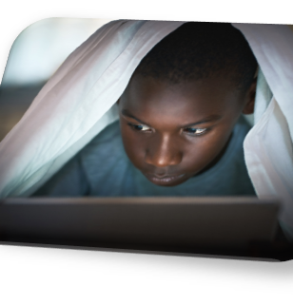
Harmful to your body
Make a list of all the things ways that using a screen for long periods of time can harm your body and mind.
Here are some ideas we have had at I.M.P.S.
The blue light from a screen can affect your sleeping
Staying up late using your screen can affect your sleeping pattern
Eyes focusing on a small screen can affect your eyesight
Posture – you can develop back and neck problems when you are older
You can get headaches
Concentration – you can only concentrate for around 20 – 30 minutes without a break

Slide 8

Your mission
Reduce your screen time
Think about how you can reduce your screen time over a week. Here is a list of some things to help you.
Have regular exercise snacks. This means you get up and leave your screen, go outside if you can and “snack” on some exercise for 5 or 10 minutes.
Instead of texting or FaceTiming your friends, why don’t you talk to them on the phone instead? That way you give your eyes a rest.
Don’t use a screen for at least 2 hours before bedtime as too much ‘blue light’ affects your sleep.
Listen to some music instead of watching something on a screen.
Ask your family to play a board game or a guessing game with you.

Slide 9
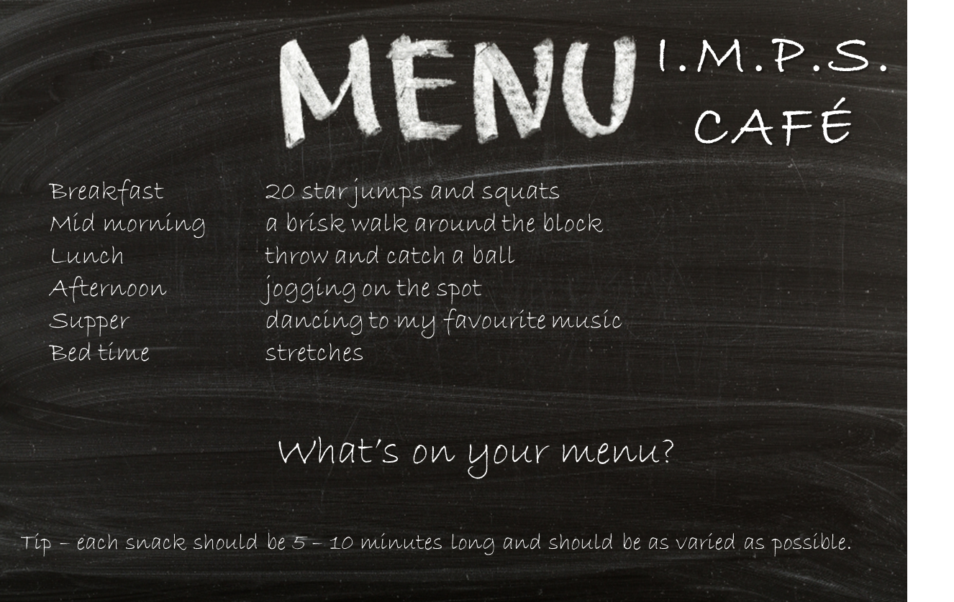

Mission ideas
Write a menu of exercise snacks

Slide 10


Make a
Now you have all the information you need to make a
plan to reduce your screen time and help your health.
This is your challenge…….
Decide to do 3 things differently for 1 week and write them on a list.
1.
2.
3.
After a week you need to repeat your first exercise and record how much time you spend on a screen.
Are you spending less time on each screen?
Where have you been able to save most time?
Do you feel better in yourself?
Please share your findings with I.M.P.S. You can send us a message by following this link.

Slide 11

Thank you
Don’t forget to let I.M.P.S. know all about your missions!

Slide 12


