Slide 1
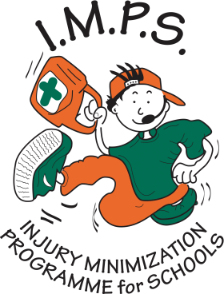
Blow the whistle on sunburn
Will you help I.M.P.S. to keep your younger brothers and sisters safe?
#safetoys

Slide 2
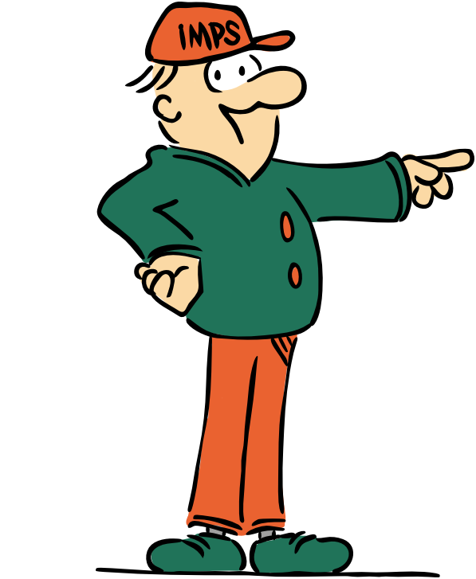
Welcome to the I.M.P.S. team!
Now you are in year 6 you automatically become a member of the I.M.P.S. team!
I.M.P.S. is a special programme that teaches you how to be responsible for the risks you take and how to make them safer. It also teaches you what to do in an emergency.
Every month we are going to give you an I.M.P.S. mission to complete. We would love it if you let us know what you do at your school and send us some images.
Find out more about I.M.P.S. at www.impsweb.co.uk Your teacher will do some lessons with you and book a visit from our I.M.P.S. trainers to teach you lots of useful emergency skills.

Slide 3

Blow the whistle on sunburn
What do you know about keeping safe in the sun?
List three reasons to keep safe in the sun.
Sunburn, risk of skin cancer when you are older, heat stroke, damage to your eyes, dehydration, headaches.
Did you think of more?

Slide 4

Did you know?
Exposure to the sun can damage the DNA in our skin
Over exposure to the sun or sunburn in childhood can cause skin cancer when you are older.
Using sun lamps or sun beds can increase the risk of developing skin cancer

Slide 5
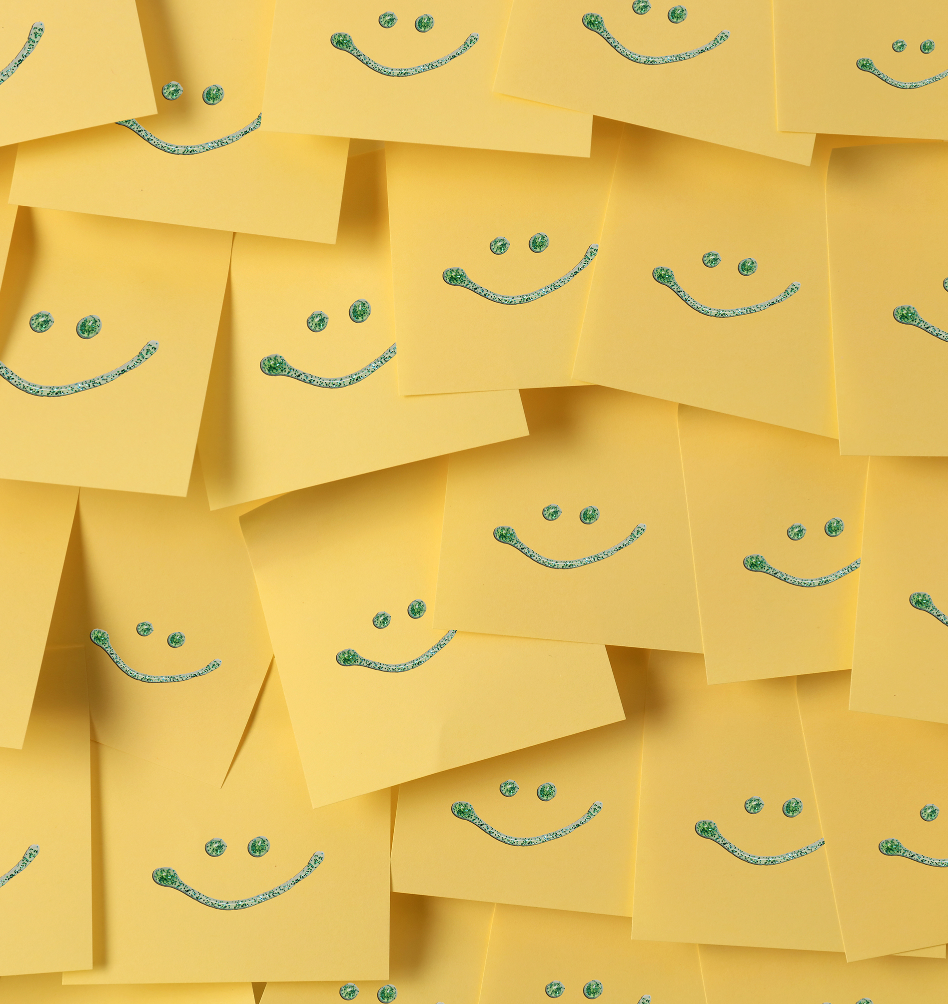
How can you stay safe in the sun?
On a post it note write down a check list for staying safe in the sun.

Slide 6
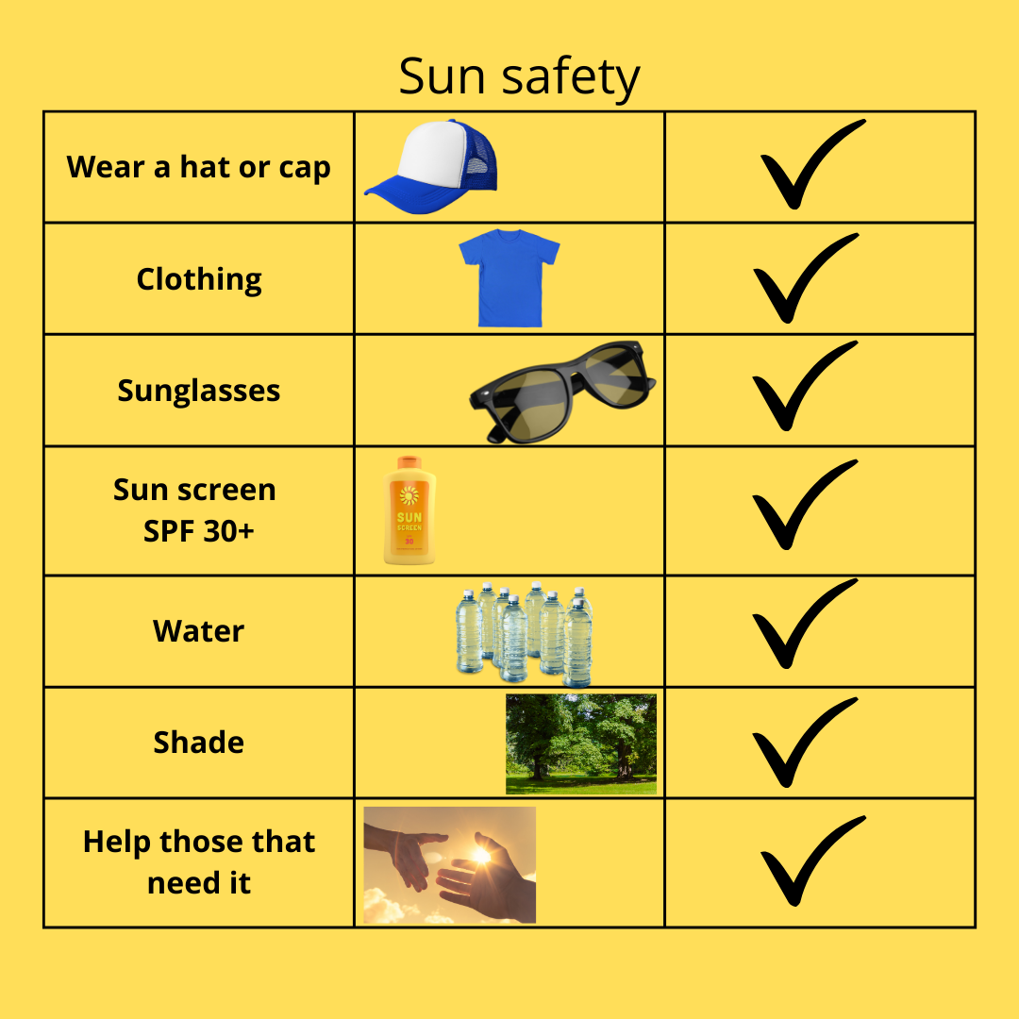
Did you forget anything?

Slide 7
Write five class rules about keeping safe in the sun
1.
2.
3.
4.
5.

Slide 8
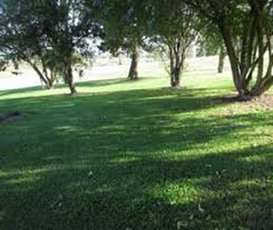
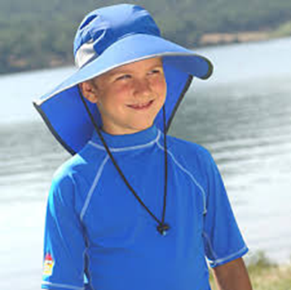
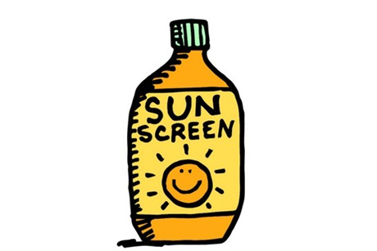
Three best ways to enjoy the sun safely are:
Shade.
Clothing.
Sun screen.

Slide 9
Try our quiz about sun safety
When are the sun’s rays at their strongest?
Between 11am and 3pm you should always wear sunscreen and take frequent breaks from the sun by going indoors or moving into the shade.

Slide 10
What do the letters SPF stand for on your sunscreen?
The letters SPF stand for sun protection factor.
Use a sunscreen with an SPF rating of 30 or higher. Put on sunscreen 15 to 20 minutes before going out in the sun. Reapply sunscreen at least every 2 hours, just to be safe.

Slide 11
Can you name 5 parts of your body that you might forget to protect with sunscreen?
The tops of your ears.
The tops of your feet.
The back of your neck.
The parting in your hair.
Your face.

Slide 12
What other ways can you protect yourself from the sun?
Wear a hat or a cap.
Wear sunglasses to protect your eyes.
Wear loose fitting clothing with long sleeves.
Stay in the shade.

Slide 13
Drink water
Wear loose clothing made of natural fibres
Stop and rest if you feel hot
Stay in the shade whenever possible
How can you keep
cool in the sun?

Slide 14

Your mission
Pass on sun safety tips to your family and friends.
Write a list of class sun safety rules and share it with the rest of the school. (send a copy to I.M.P.S)

Slide 15

Mission ideas
Posters.
Leaflets.
Talk to people about the dangers of the sun!
Do an assembly in school.
Write an article outlining how to keep little ones safe in the sun for the school newsletter.
Show the younger children in the school how you keep yourself safe in the sun. (they really look up to you!)
Write a list of class sun safety rules and share with the rest of the school.

Slide 16
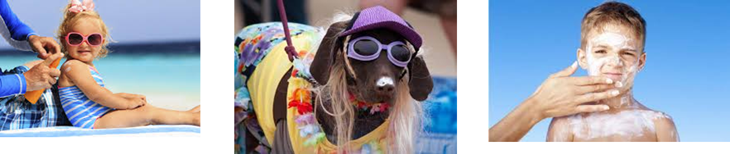
Please send us some photos of your class looking cool in the sun for our website gallery.

Slide 17
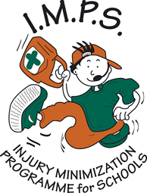
Thank you
Don’t forget to let I.M.P.S. know all about your missions!

Slide 18


