Slide 1

Road Safety Week 2023

Slide 2

Welcome to the I.M.P.S. team!
Now you are in year 6 you automatically become a member of the I.M.P.S. team!
I.M.P.S. is a special programme that teaches you how to be responsible for the risks you take and how to make them safer. It also teaches you what to do in an emergency.
Every month we are going to give you an I.M.P.S. mission to complete. We would love it if you let us know what you do at your school and send us some images.
Find out more about I.M.P.S. at www.impsweb.co.uk Your teacher will do some lessons with you and book a visit from our I.M.P.S. trainers to teach you lots of useful emergency skills.

Slide 3


Road Safety Week November 19th – 25th 2023.
Talk about speed.
At higher speeds, vehicles hit harder and cause more severe injuries.
Discuss any good road safety measures around your school, for example,
Is there a school sign warning drivers to drive more slowly?
Are there zig zag lines to prevent cars from parking right outside school, pelican crossings, footbridges or underpasses?
Are there 20mph limits, barriers or fences, wide pavements?

Slide 4
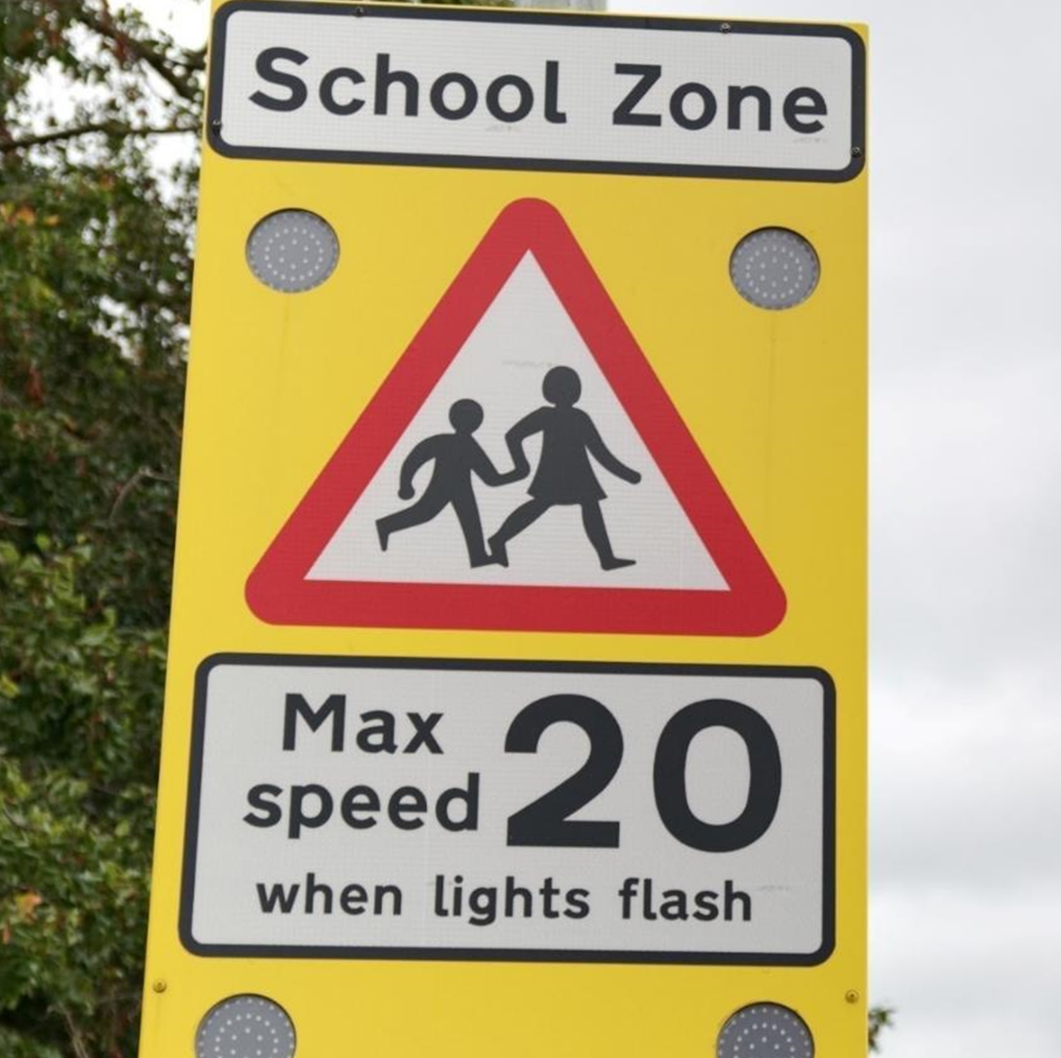
Some things to think about.
Think about the traffic around your school or around where you live.
Do you think it travels fast?
Do you feel safe walking or cycling near school/where you live?
Does fast traffic make you feel frightened or worried?
Is the traffic noisy, or smelly? Does it make it dangerous for people to walk and cycle?

Slide 5

Road safety facts.
More than six children are seriously hurt or killed every single day on UK roads.
Fast traffic is dangerous, frightening and noisy.
All vehicles are heavy and hard and can hurt us very badly if they hit us.
At higher speeds, vehicles hit harder and cause more severe injuries.
Slower speeds save lives.

Slide 6
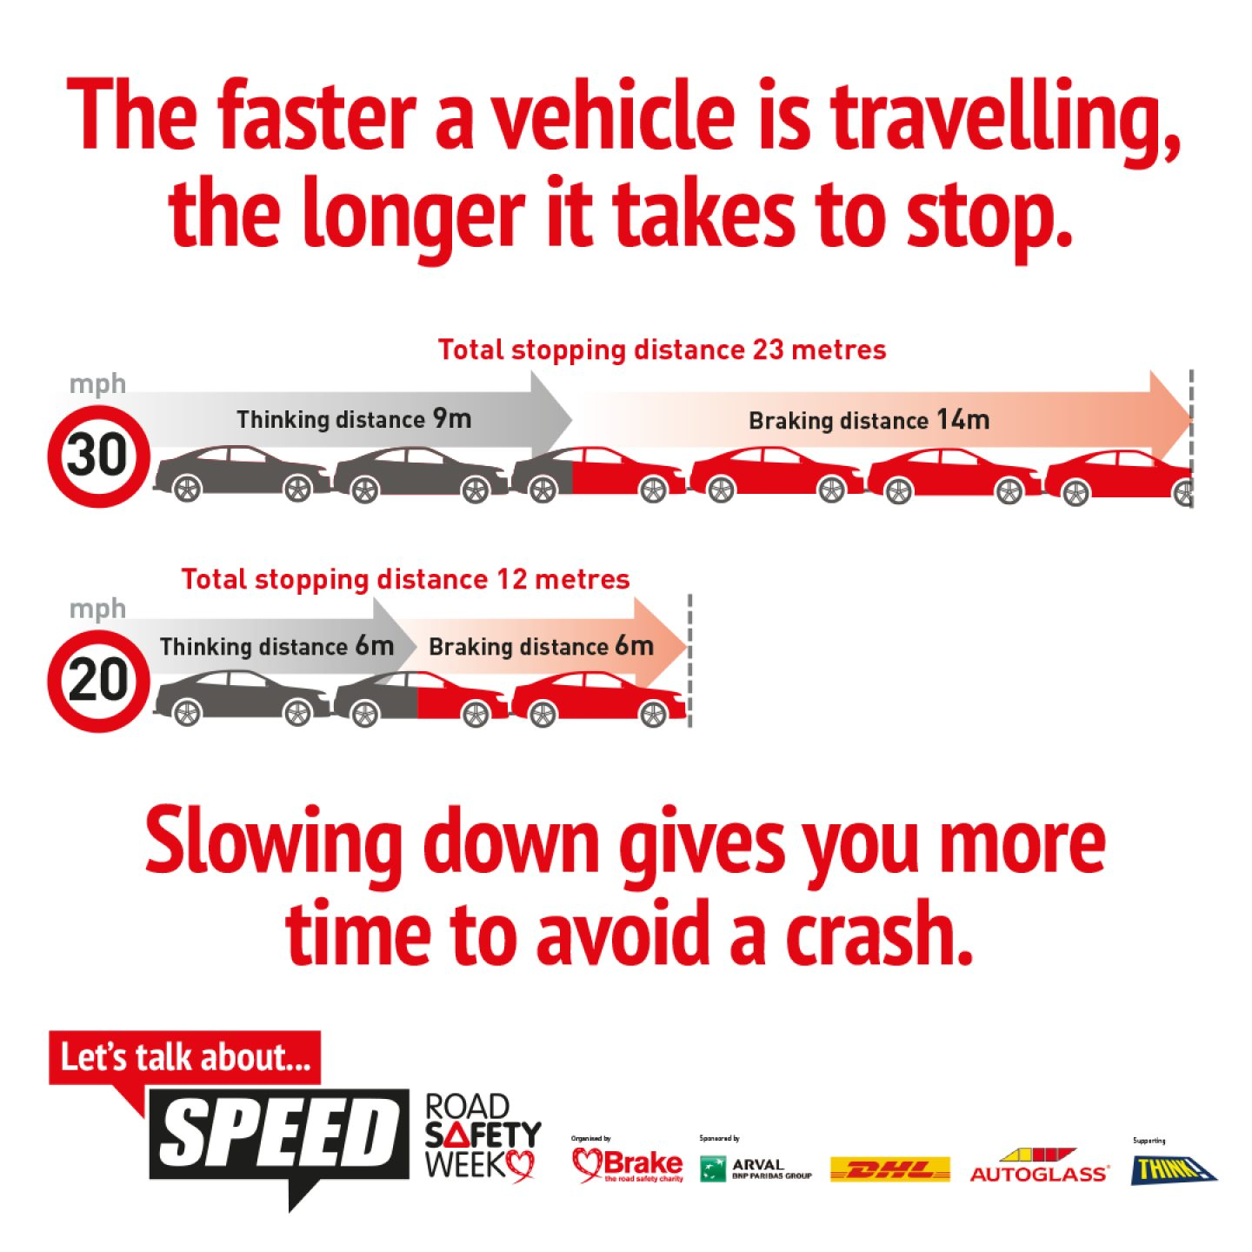
Speed and stopping distances.
Measure out these distances in the playground so you can see how long it takes a car to stop at 30 and 20 miles an hour.
What do you think will happen to these distances in wet weather?
What do you think will happen to these distances if the driver is tired or distracted?

Slide 7

Did you know?
5 people die on UK roads every day.
It takes 23 metres for a car to stop if it is travelling at 30 miles an hour.
The speed limit is the top speed you should travel on that road. (it doesn’t mean it is safe to drive at this speed in all conditions)

Slide 8
Quiz
What is the speed limit on the road outside your school?
How many people die each day in road traffic accidents?
5 people die every day
Should you always drive at the speed limit on all roads all the time?
No. The speed limit is the maximum speed you should travel. It is often safer to go slower especially in bad weather and when there are cyclists and pedestrians.
How many metres does it take to stop in a car travelling at 30 miles per hour?
It takes 23 metres for a car to stop when it is travelling at 30 miles an hour.

Slide 9
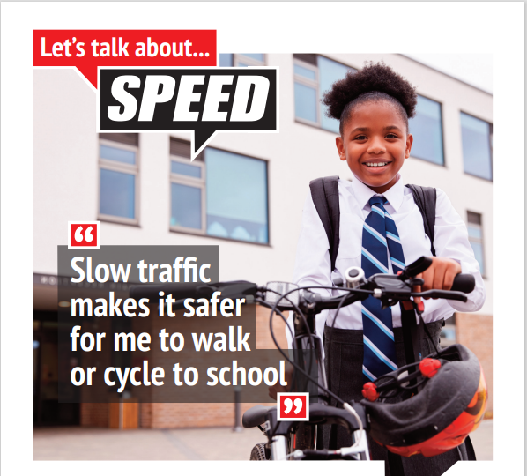

Your mission
Your mission this month is to encourage the adults who drive the cars to think:
about the speed they travel.
and how they can make their journeys safer.

Slide 10

Mission ideas
Split into groups and talk about what the traffic is like outside your school.
Are there 20 mile an hour limits in place?
Is there a safe place to cross?
Are there any problems outside your school?
Write a traffic report for the radio about the conditions outside your school.
Write a newspaper article about the traffic outside your school.
Make a poster or leaflet to take home with you about the dangers of speeding.
Do an assembly in school for the younger children to make them aware of how dangerous it is to speed on roads.

Slide 11

Thank you
Don’t forget to let I.M.P.S. know all about your missions!
(we would love to put them on our website and in our newsletters.)
www.impsweb.co.uk

Slide 12


