Slide 1
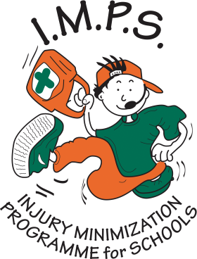
Water Safety
Drowning Prevention Week 14th – 21st June 2025
Notes:
Information for the person taking the assembly

Slide 2

Welcome to the I.M.P.S. team!
Now you are in year 6 you automatically become a member of the I.M.P.S. team!
I.M.P.S. is a special programme that teaches you how to be responsible for the risks you take and how to make them safer. It also teaches you what to do in an emergency.
Every month we are going to give you an I.M.P.S. mission to complete. We would love it if you let us know what you do at your school and send us some images and news for our website.
Find out more about I.M.P.S. at www.impsweb.co.uk Your teacher will do some lessons with you and book a visit from our I.M.P.S. trainers to teach you lots of useful emergency skills.

Slide 3
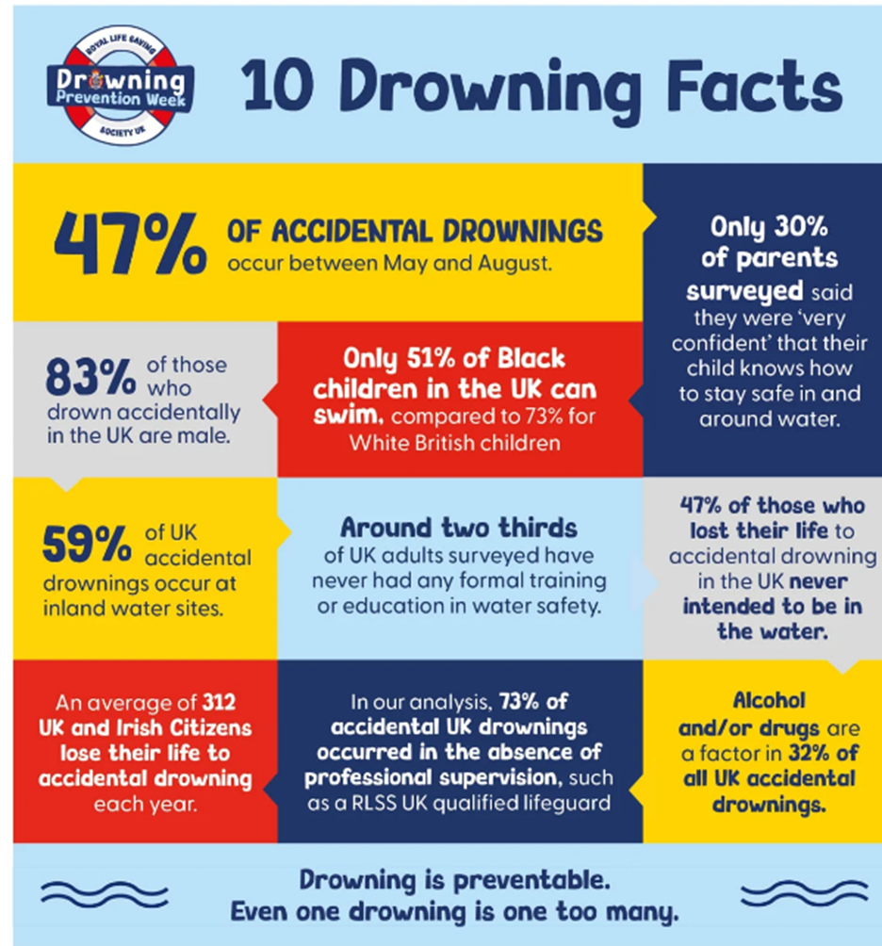

Water safety - some facts
Have a look at these Drowning facts and try to answer the following questions.
Why do you think 47% of accidental drownings occur between May and August?
Why do you think that 73% of accidental drownings happened without a lifeguard being there?
Where do you think most of these drownings took place?

Slide 4
Where is it safe to swim?
Think of all the places that you could swim.
Here are 5 top tips to make sure the swimming place is safe.
Look out for Lifeguards
Only swim where there is a qualified lifeguard or under adult supervision.
Remember it’s colder than it looks
Open water and inshore water (lakes, gravel pits and rivers) are often very cold and this can affect your body with cold water shock so you can’t save yourself.
Don’t go too far
Make sure you stay close to the shore so you can be spotted if you get into trouble in the water
Remember it’s stronger than it looks
Currents in the water can be very strong and you can tire quickly if you are caught in one.
Never swim alone
Always bring a friend or an adult when you are swimming so that there is someone to look out for you.
Think about your list of swimming places again and decide which ones are safe for you to swim in.

Slide 5
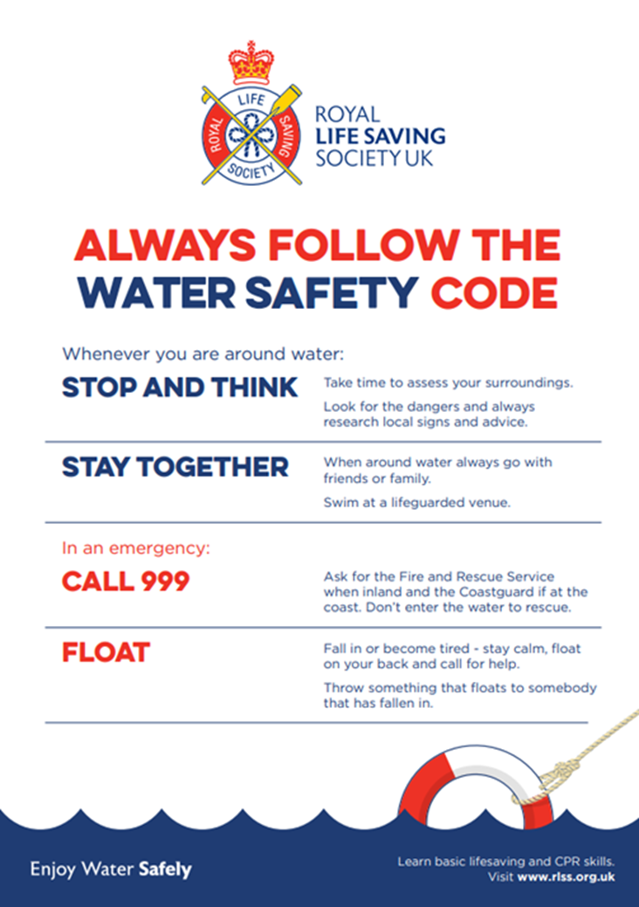
Remember
Cold water shock can happen if you jump or fall into lakes, gravel pits, the sea, canals or rivers. This can cause changes to your breathing, blood pressure and muscles which makes it difficult to swim or save yourself.

Slide 6
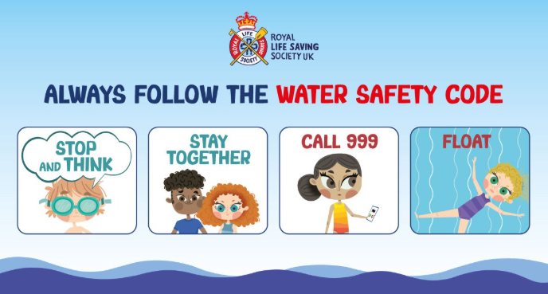
A reminder of the Water Safety top tips
Click the picture to watch a film about keeping safe near water.
https://youtu.be/zwzB7So7jSM

Slide 7
Quiz
Can you name the 5 top tips for staying safe in water?

Slide 8
Quiz
Look out for Lifeguards
Only swim where there is a qualified lifeguard or under adult supervision.
Remember it’s colder than it looks
Open water and inshore water (lakes, gravel pits and rivers) are often very cold and this can affect your body with cold water shock so you can’t save yourself.
Don’t go too far
Make sure you stay close to the shore so you can be spotted if you get into trouble in the water
Remember it’s stronger than it looks
Currents in the water can be very strong and you can tire quickly if you are caught in one.
Never swim alone
Always bring a friend or an adult when you are swimming so that there is someone to look out for you.
Can you name the 5 top tips for staying safe in water?

Slide 9
Quiz
Which months do most accidental drownings happen in?

Slide 10
Quiz
Which months do most accidental drownings happen in?
Between May and August

Slide 11
Quiz
How can you make sure you stay safe in water?

Slide 12
Quiz
How can you make sure you stay safe in water?
Only swim where there is a qualified lifeguard or responsible person to keep a look out for you.
Beware of swimming in rivers, lakes, canals or gravel pits. It can be cold and cause cold water shock. You also don’t know what is lying underneath the water which can make it very dangerous to swim there and you can easily get out of your depth.

Slide 13

Did you know?
Drowning is the third highest cause of accidental death of children in the UK.

Slide 14

Your mission
Your mission is to make sure that your friends and family are aware of the dangers of swimming in places without a lifeguard.
Ask your teacher to download some resources from the Royal Life Saving Society to help you with your message.

Slide 15
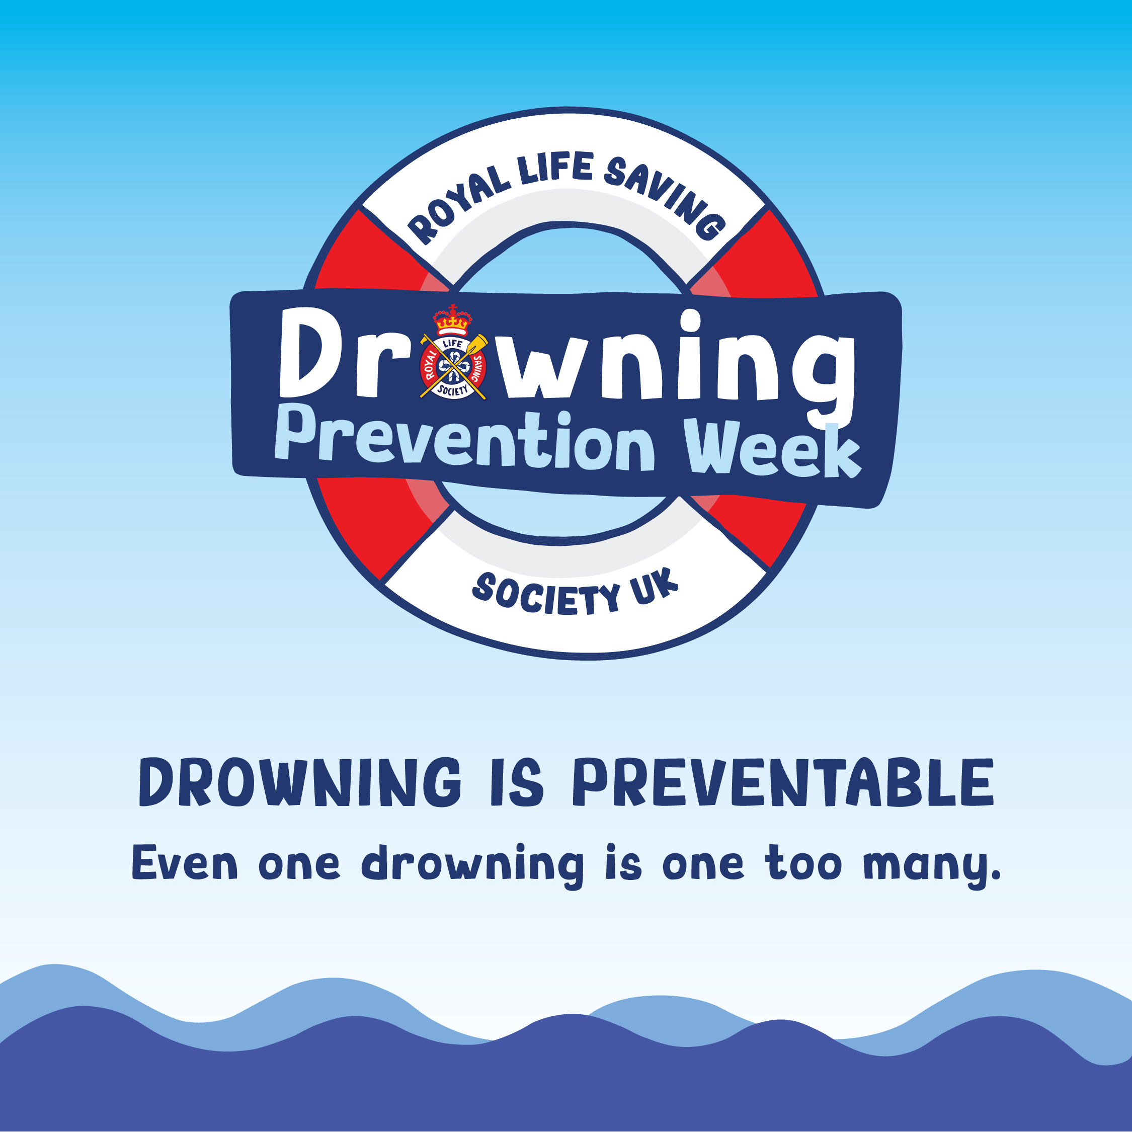

It’s drowning prevention week
June 14th – 21st 2025
Help I.M.P.S. to pass on the water safety message and prevent accidental drownings this summer.
Remember to keep yourself safe even if your friends think it is a good idea to play unsupervised near dangerous water.

Slide 16
Mission ideas
Make a poster or booklet.
Talk to your family and friends (especially older brothers and sisters!) about the dangers of swimming, playing and jumping in unsupervised water.
Write something for the school newsletter or website explaining the dangers of water.
Join in with the RLSS non-uniform day and dress in red and yellow.

Slide 17

Thank you
Don’t forget to let I.M.P.S. know all about your missions!

Slide 18


